Slide 1
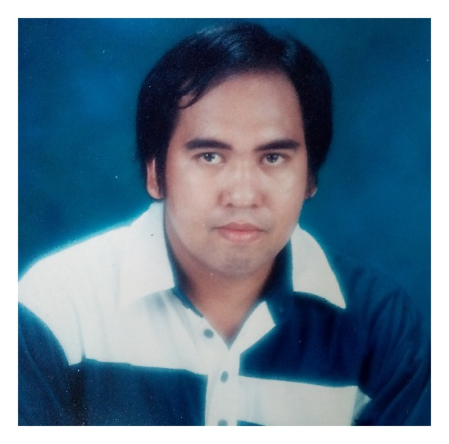
LECTURE ON LIS ver. 2 for SCHOOL HEADS
BY
ALFREDO C. MEDRANO
Planning Officer II
DIVISION OF ILOCOS NORTE
Region I
By Alfredo Medrano, Planning Officer II-Ilocos Norte

Slide 2
REMINDER:
Before you will go on, please consider these reminder
Do not use arrow keys to go to the next slide
Click these symbol:
NEXT SLIDE
PREVIOUS SLIDE
HOME (RETURN TO TOPIC (CONTENTS)
By Alfredo Medrano, Planning Officer II-Ilocos Norte

Slide 3

TABLE OF CONTENTS
“Click the Topic you want to display”
ACCESSING THE LIS VER 2 – GETTING STARTED – FIRST LOG IN
CREATING NEW CLASS/SECTION
EDIT PROFILE OF PUPIL/STUDENT ENROLLED
CREATING AN LRN OF PUPILS/STUDENTS
DOWNLOADING/PRINTING OF SCHOOL FORMS
REMOVING UN-NECESSARY SECTION/CLASS
ENROLLING PUPILS/STUDENTS WHO ARE ENROLLED IN THE PREVIOUS SCHOOL YEAR
HOW TO CHANGE PASSWORD
HOW TO SIGN OUT
HOW TO LOGIN (SECOND TIME AND SO FORTH………..)
HOW TO SEARCH LEARNER WITH LRN
Enrolling Individual Pupil/Student with
HOW TO MANAGE/ADD CLASS ADVISER ACCOUNT
HOW TO SEARCH LEARNER WITHOUT LRN
UN-ENROL PUPIL/STUDENT IN A GRADE AND SECTION
ASSIGNING AN ADVISER TO A CERTAIN CLASS/SECTION
HOW TO RESET PASSWORD OF CLASS ADVISER

Slide 4
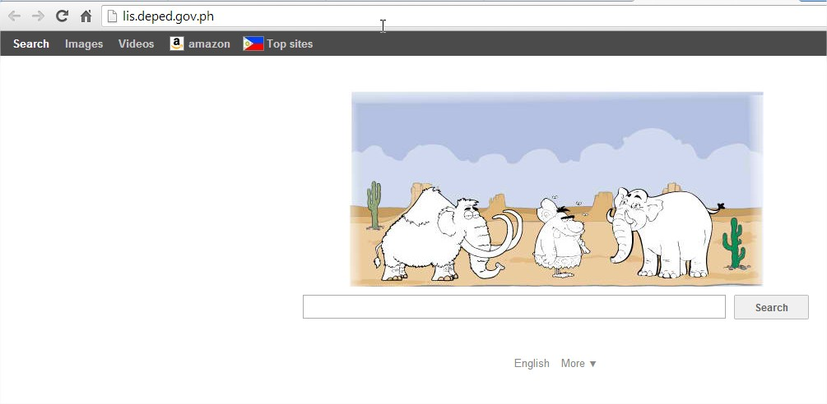
GETTING STARTED
To access the LIS, type lis.deped.gov.ph at the address or location bar of a web browser, then press Enter.
By Alfredo Medrano, Planning Officer II-Ilocos Norte

Slide 5
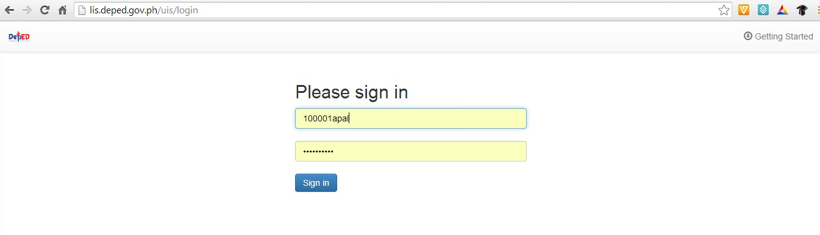
This will connect you to the LIS login page as shown in (Figure 1.1-1: Login Page). Enter your username and password, then click the “Sign In” button.
A successful login will direct the user to the LIS Dashboard
At the onset, a school may use the same account details as in the EBEIS. In this case, the user is first
directed to an account validation facility or the “Account Check” page.
USE THE EBEIS USERNAME AND PASSWORD, IF YOU FORGOT, PLEASE CALL YOUR PLANNING OFFICER TO RESET, RESETTING MEANS USERNAME AND PASSWORD ARE THE SAME
Figure 1.1-1: Login Page
By Alfredo Medrano, Planning Officer II-Ilocos Norte

Slide 6
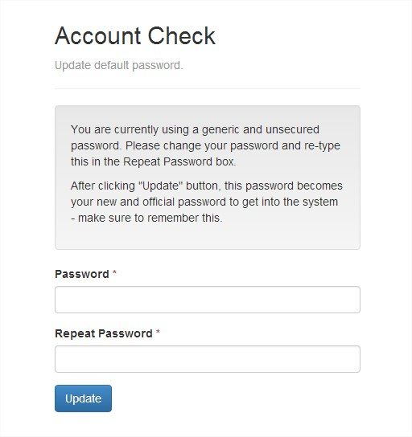
Figure 1.2-1: Account Check
If it is your first time to login using the default school user account, the system will prompt you to change your default password in the “Figure 1.2-1: Account Check (Update Password) page”. Enter your new password twice then click “Update” button to save your changes. Upon completing the password change, the system displays the message “password changed”.
By Alfredo Medrano, Planning Officer II-Ilocos Norte

Slide 7
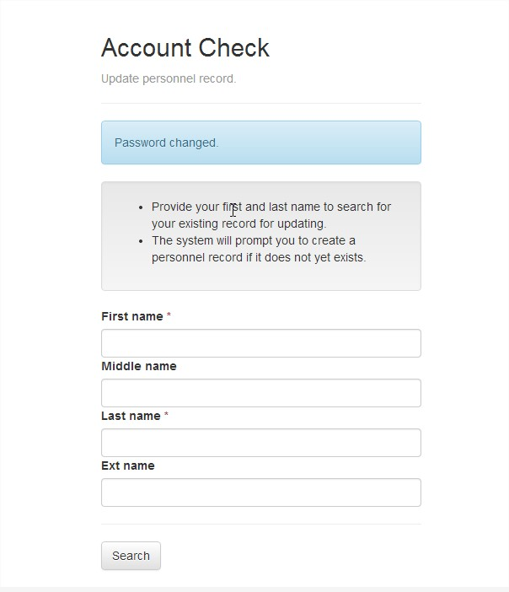
After typing the New Password, it displayed Password changed (pls. don’t forget to record your password)
Type the First Name, Middlename and Lastname of the School School Head, then click Search
By Alfredo Medrano, Planning Officer II-Ilocos Norte

Slide 8
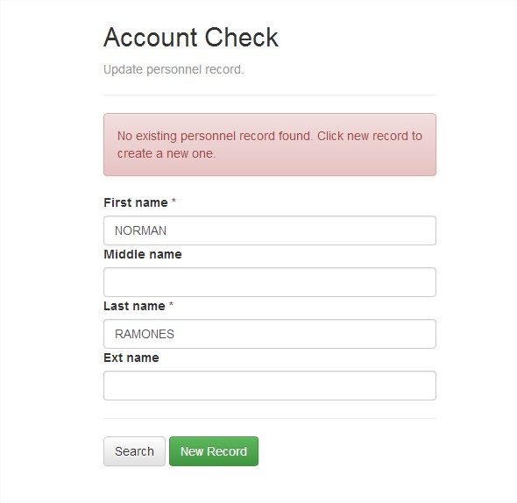
No existing personnel record found, Click new record to create new one, Click New Record
By Alfredo Medrano, Planning Officer II-Ilocos Norte

Slide 9
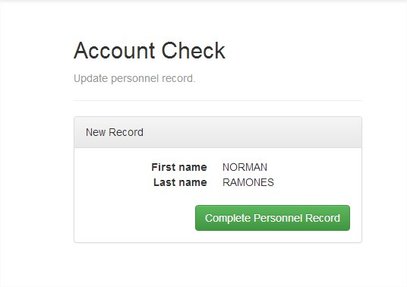
Click Complete Personnel Record
By Alfredo Medrano, Planning Officer II-Ilocos Norte

Slide 10
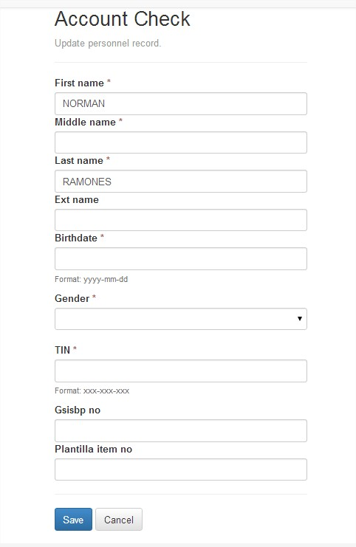
Fill up the required field, then click SAVE
By Alfredo Medrano, Planning Officer II-Ilocos Norte

Slide 11
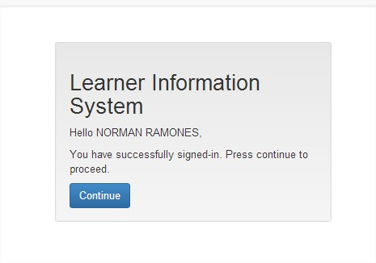
Click Continue
By Alfredo Medrano, Planning Officer II-Ilocos Norte

Slide 12
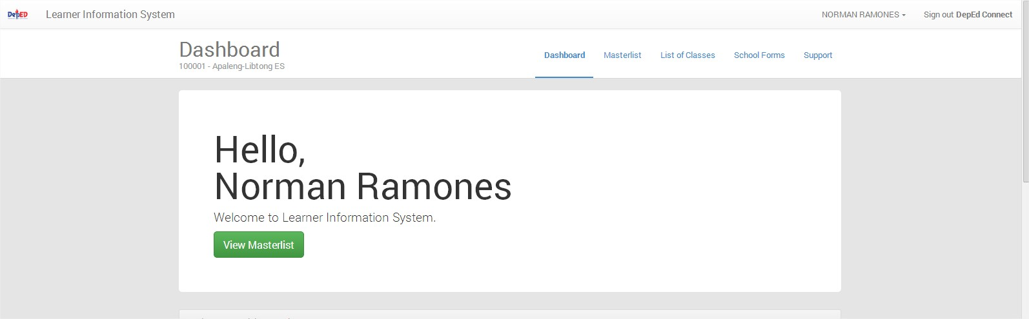
This is the School DASHBOARD, click View Masterlist
By Alfredo Medrano, Planning Officer II-Ilocos Norte

Slide 13
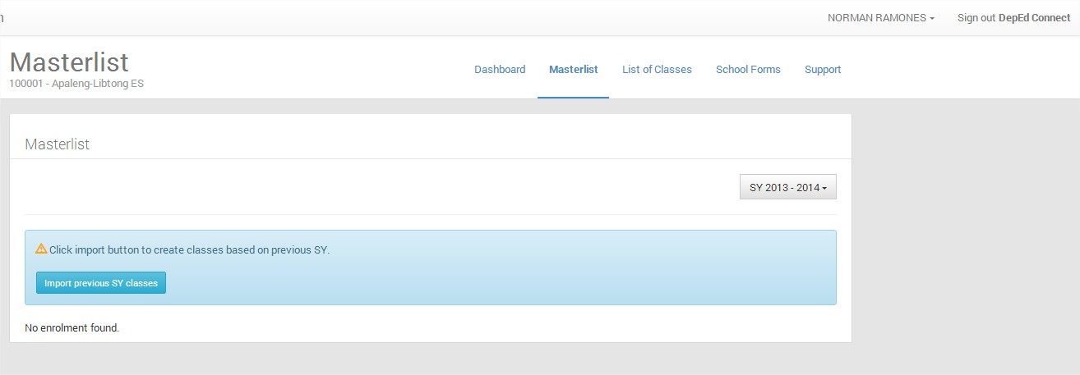
Since you are viewing the Current School Year, so you can see No enrolment found, Click Import previous SY classes to create classes based on previous SY
By Alfredo Medrano, Planning Officer II-Ilocos Norte

Slide 14
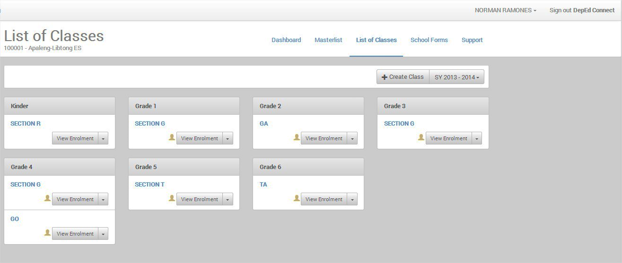
Click List of Classes to display the Imported Classes from previous School Year
CLICK HERE
END OF THE TOPIC – CLICK HOME TO GOTO TOPIC
By Alfredo Medrano, Planning Officer II-Ilocos Norte

Slide 15
Click this ICON to return to TABLE OF CONTENTS
By Alfredo Medrano, Planning Officer II-Ilocos Norte

Slide 16
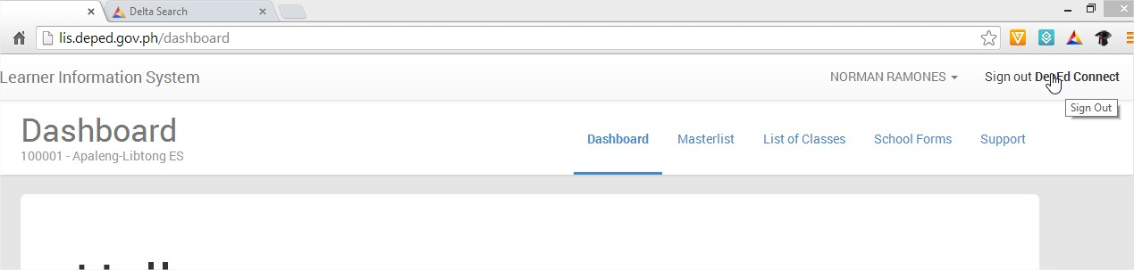
SIGNOUT LIS
Click Sign out DepEd Connect
CLICK HERE
END OF THE TOPIC – CLICK HOME TO GOTO TOPIC
By Alfredo Medrano, Planning Officer II-Ilocos Norte

Slide 17
Click this ICON to return to TABLE OF CONTENTS
By Alfredo Medrano, Planning Officer II-Ilocos Norte

Slide 18
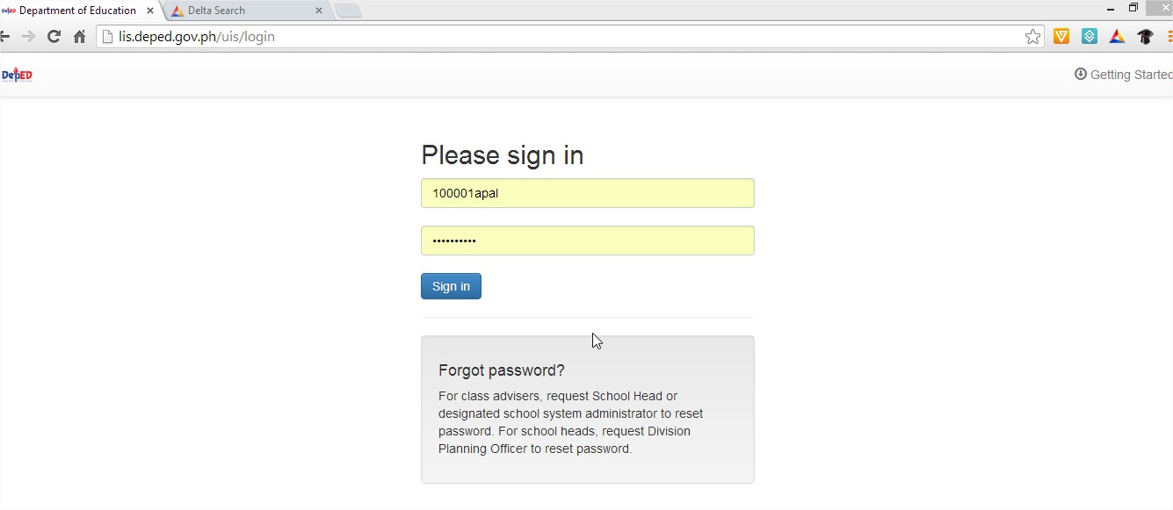
LOG IN FOR THE SECOND TIME AND SO FORTH….
Type lis.deped.gov.ph in the address bar
Type USERNAME AND NEW PASSWORD, THEN CLICK SIGN IN
By Alfredo Medrano, Planning Officer II-Ilocos Norte

Slide 19
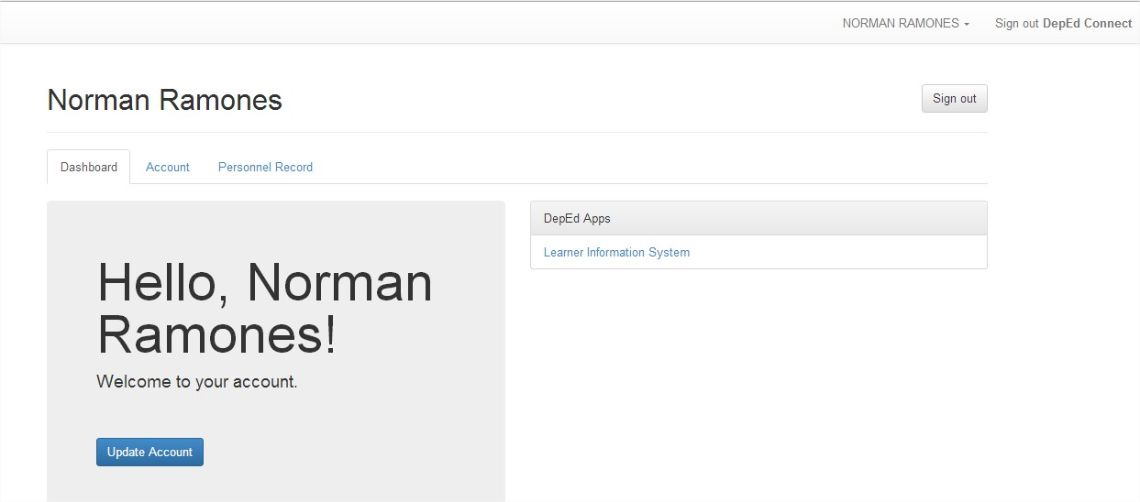
CLICK Learner Information System
By Alfredo Medrano, Planning Officer II-Ilocos Norte

Slide 20
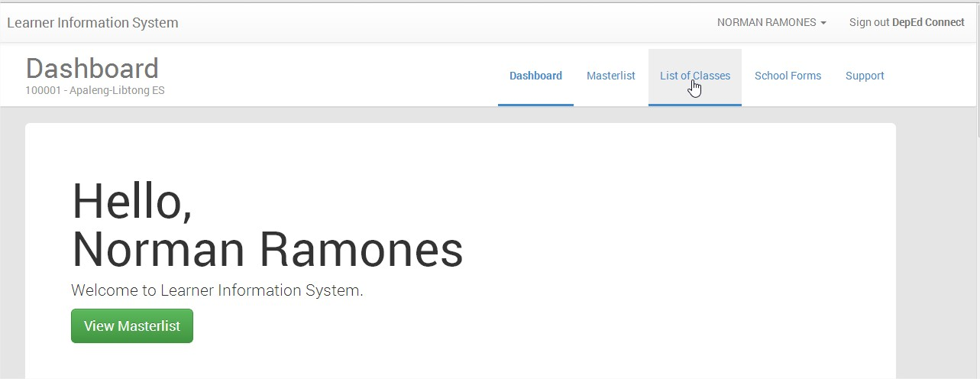
MENU
Click List of Classes or any of the Menu
MAIN MENU
By Alfredo Medrano, Planning Officer II-Ilocos Norte

Slide 21
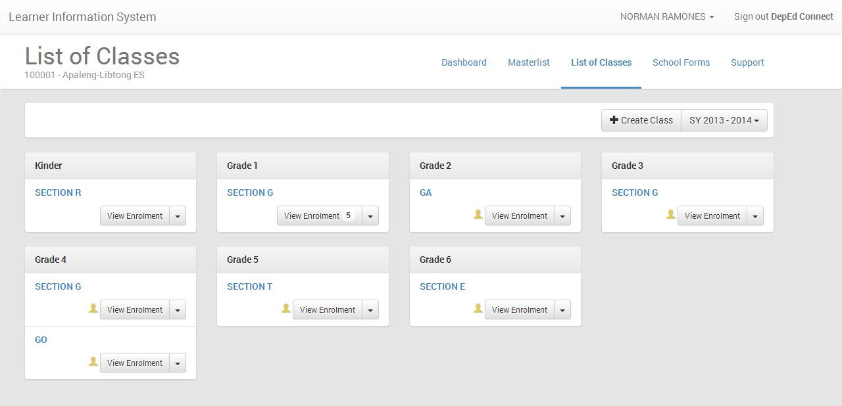
In here, you can now do what you want, like Enroll, Create LRN, etc
CLICK HERE
END OF THE TOPIC – CLICK HOME TO GOTO TOPIC
By Alfredo Medrano, Planning Officer II-Ilocos Norte

Slide 22
Click this ICON to return to TABLE OF CONTENTS
By Alfredo Medrano, Planning Officer II-Ilocos Norte

Slide 23
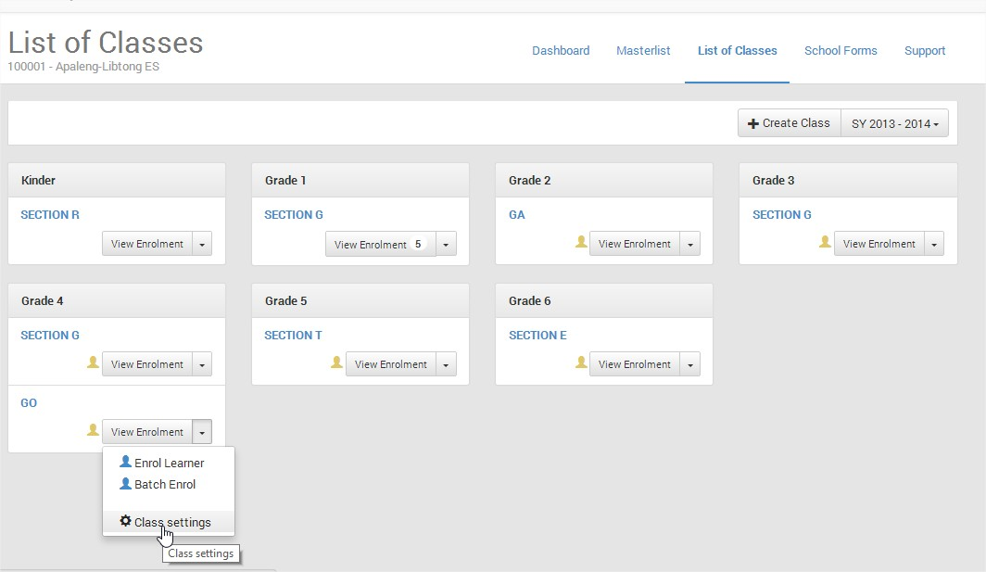
REMOVING UN-NECESSARY EMPTY SECTION OR CLASS/S
Click List of Classes, From imported Previous SY Classes, if you want to remove a class in a certain Grade/Year, select a Section/Class to remove, say Grade 4, Section GO, click pulldown menu, select Class settings
By Alfredo Medrano, Planning Officer II-Ilocos Norte

Slide 24
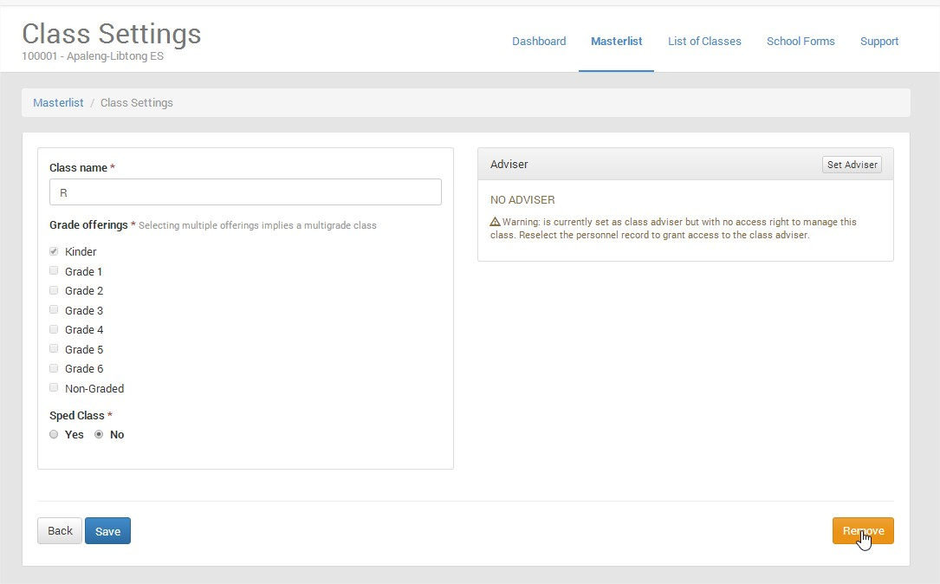
In the class settings, Click Remove, to remove the Class, it will return to the List of Classes
NOTE: You cannot remove a class with enrolment
By Alfredo Medrano, Planning Officer II-Ilocos Norte

Slide 25
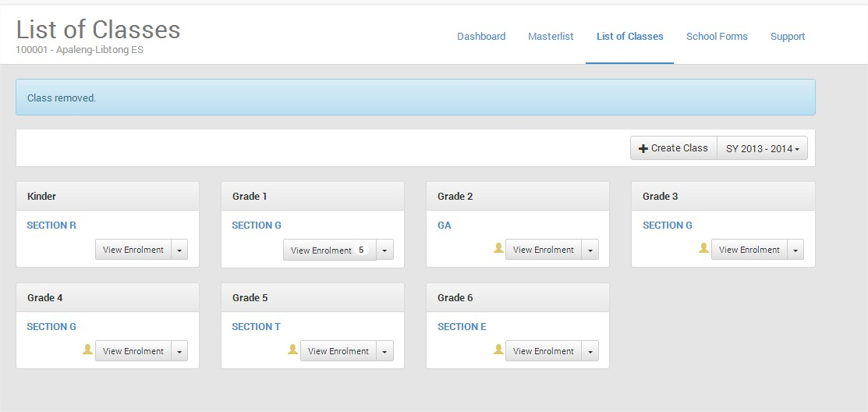
Section GO in Grade 4 is already removed
CLICK HERE
END OF THE TOPIC – CLICK HOME TO GOTO TOPIC
By Alfredo Medrano, Planning Officer II-Ilocos Norte

Slide 26
Click this ICON to return to TABLE OF CONTENTS
By Alfredo Medrano, Planning Officer II-Ilocos Norte

Slide 27
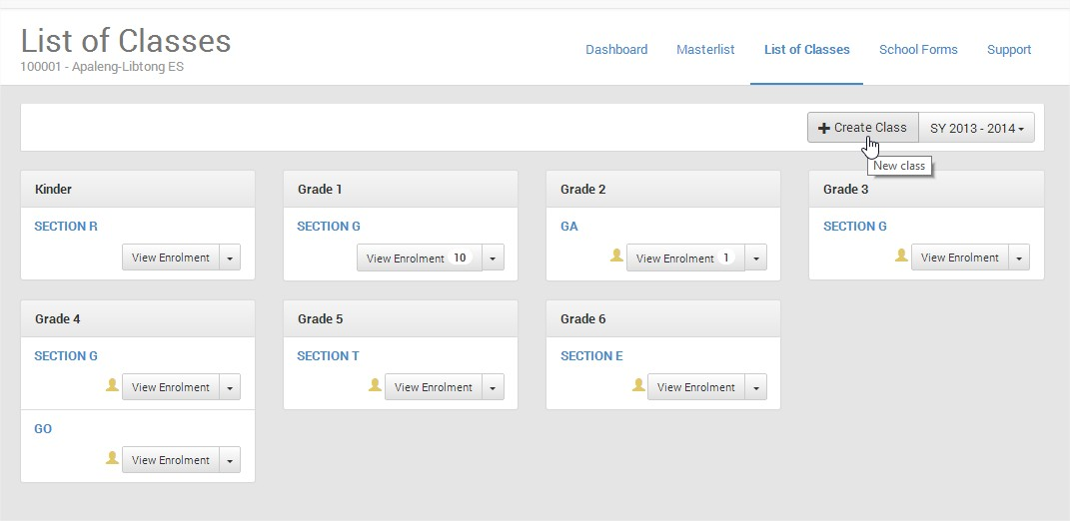
CREATING CLASS/SECTION
In the List of Classes Menu, Click Create Class
By Alfredo Medrano, Planning Officer II-Ilocos Norte

Slide 28
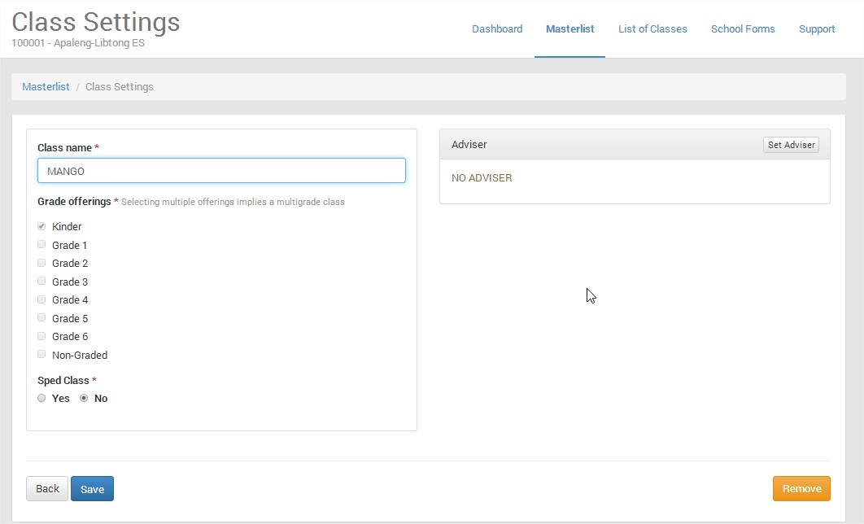
By Alfredo Medrano, Planning Officer II-Ilocos Norte

Slide 29
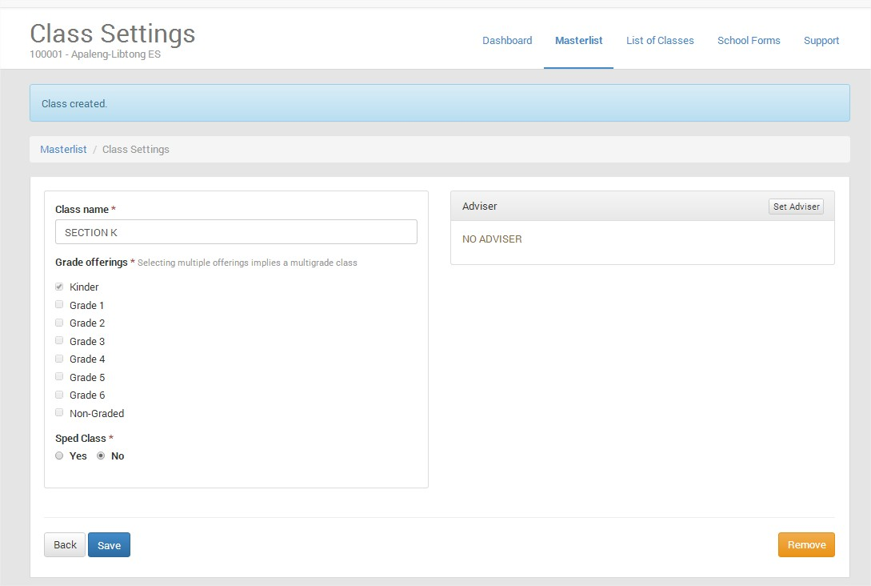
Class Create, Click List of Classes Menu
By Alfredo Medrano, Planning Officer II-Ilocos Norte

Slide 30
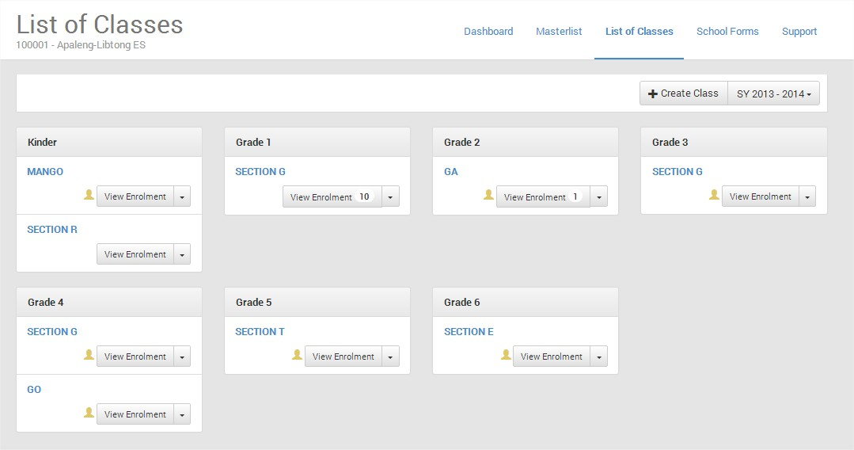
Section Mango is added in Kinder
CLICK HERE
END OF THE TOPIC – CLICK HOME TO GOTO TOPIC
By Alfredo Medrano, Planning Officer II-Ilocos Norte

Slide 31
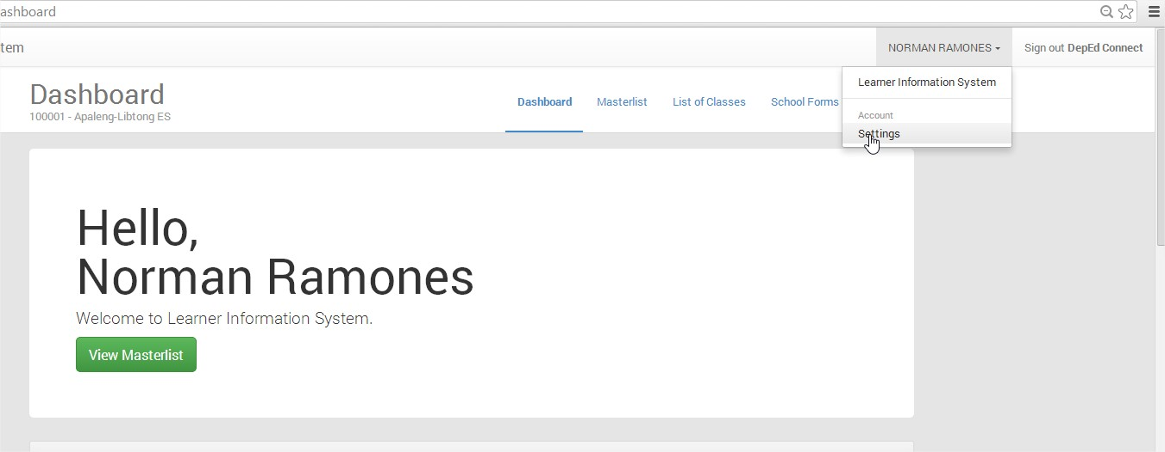
HOW TO MANAGE/ADD CLASS ADVISER ACCOUNT?
In the Dashboard (Click Dashboard Menu, Click the Pulldown Menu, Click Settings
By Alfredo Medrano, Planning Officer II-Ilocos Norte

Slide 32
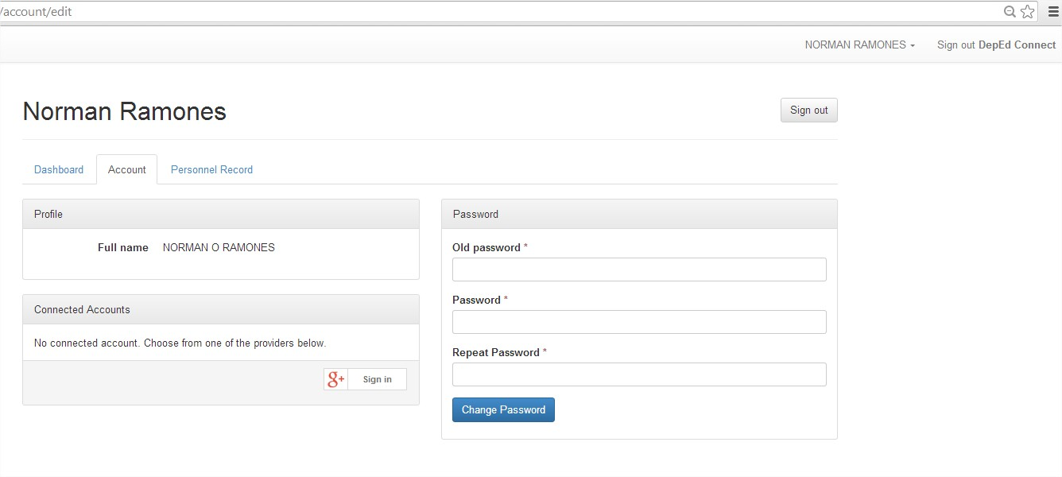
Click Personnel Record to manage personnel
By Alfredo Medrano, Planning Officer II-Ilocos Norte

Slide 33
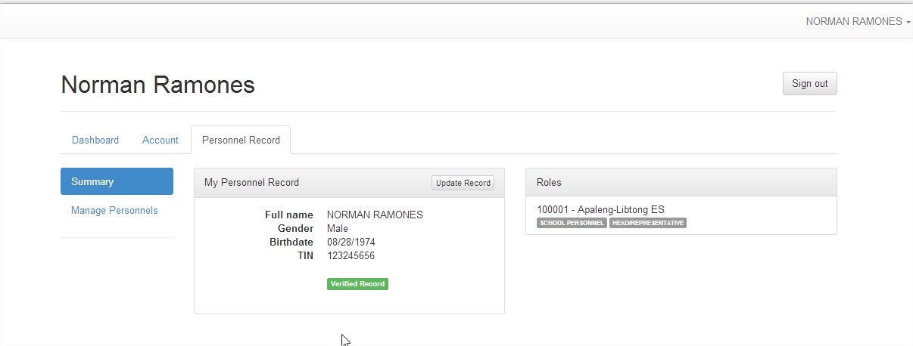
Click Manage Personnel to open the list of Personnel in the School
By Alfredo Medrano, Planning Officer II-Ilocos Norte

Slide 34
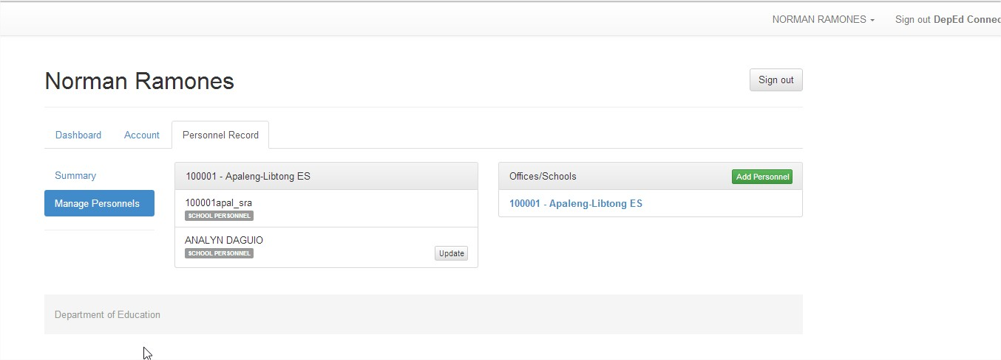
Click Add Personnel
By Alfredo Medrano, Planning Officer II-Ilocos Norte

Slide 35
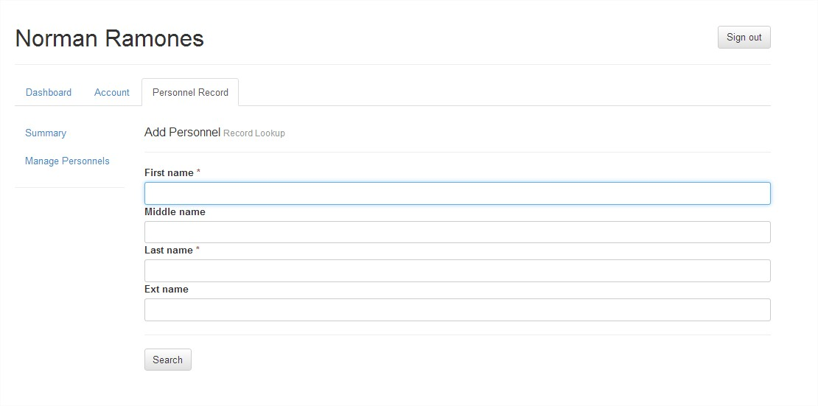
Type First Name and Last Name then click Search
By Alfredo Medrano, Planning Officer II-Ilocos Norte

Slide 36
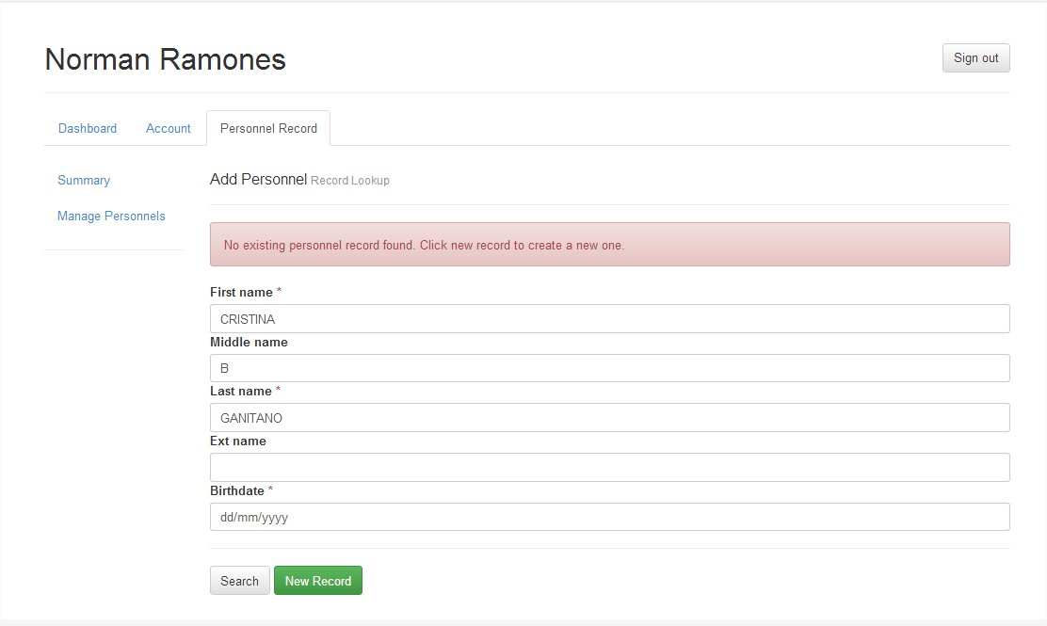
CLICK NEW RECORD
By Alfredo Medrano, Planning Officer II-Ilocos Norte

Slide 37
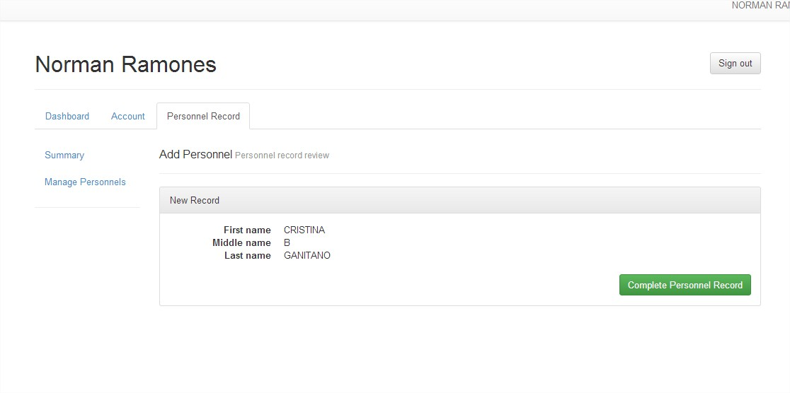
CLICK COMPLETE PERSONNEL RECORD
By Alfredo Medrano, Planning Officer II-Ilocos Norte

Slide 38
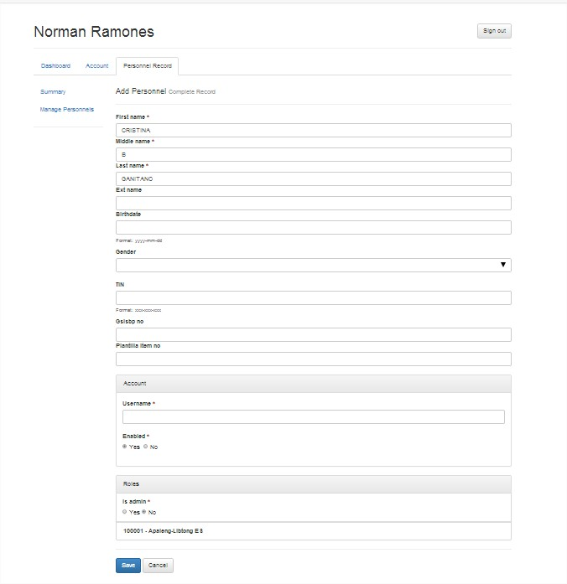
Fill up the required field for the Class Adviser
By Alfredo Medrano, Planning Officer II-Ilocos Norte

Slide 39
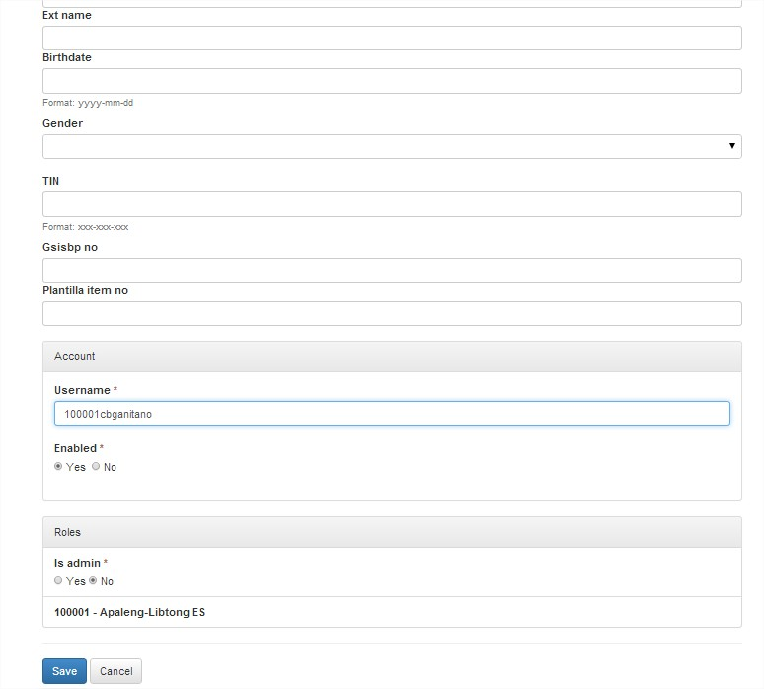
In the Username of the Class Adviser, please use this format: School ID_intial, ex. 100001acmedrano
This will be the username and default password if an adviser will log in to LIS System, then click SAVE
By Alfredo Medrano, Planning Officer II-Ilocos Norte

Slide 40
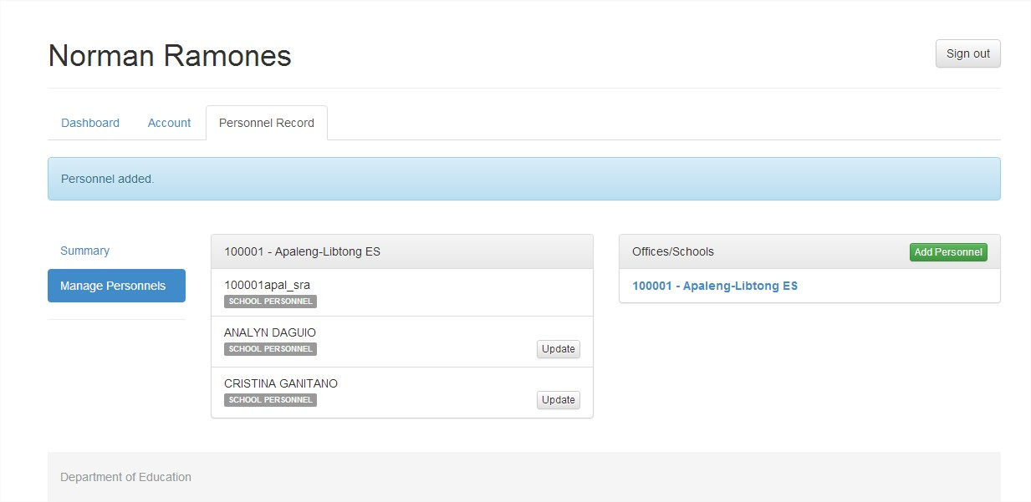
To Edit the Personnel Data, just click Update
After Saving, Personnel Added is displayed at top of the screen, if you want to Add another Personnel, please follow slide 30 to 35
End of Topic – Click Home
CLICK HERE TO GOTO SLIDE 30
By Alfredo Medrano, Planning Officer II-Ilocos Norte

Slide 41
Click this ICON to return to TABLE OF CONTENTS
By Alfredo Medrano, Planning Officer II-Ilocos Norte

Slide 42
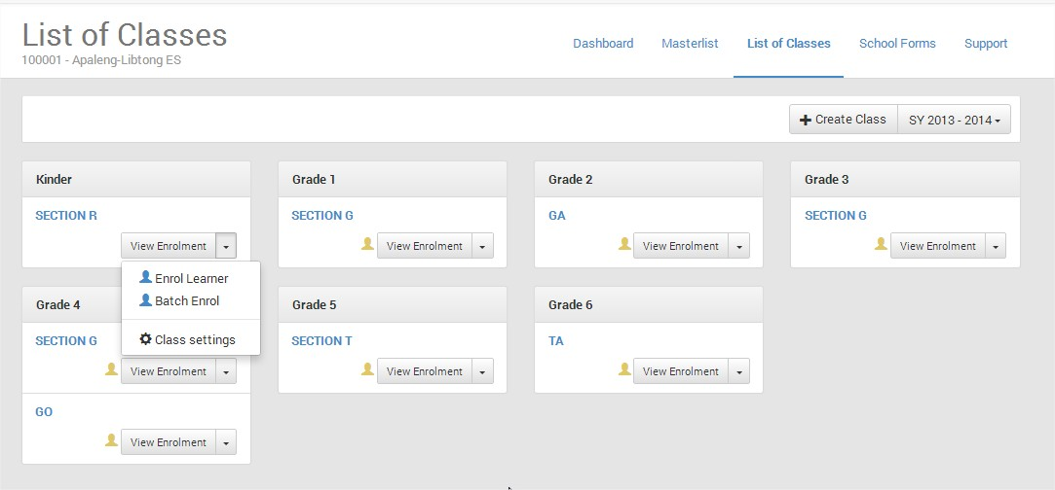
ASSIGNING AN ADVISER TO A CLASS/SECTION
Click the List of Classes Menu, select the Grade and Section you want to set Class Adviser, click pulldown menu, select Class settings
By Alfredo Medrano, Planning Officer II-Ilocos Norte

Slide 43
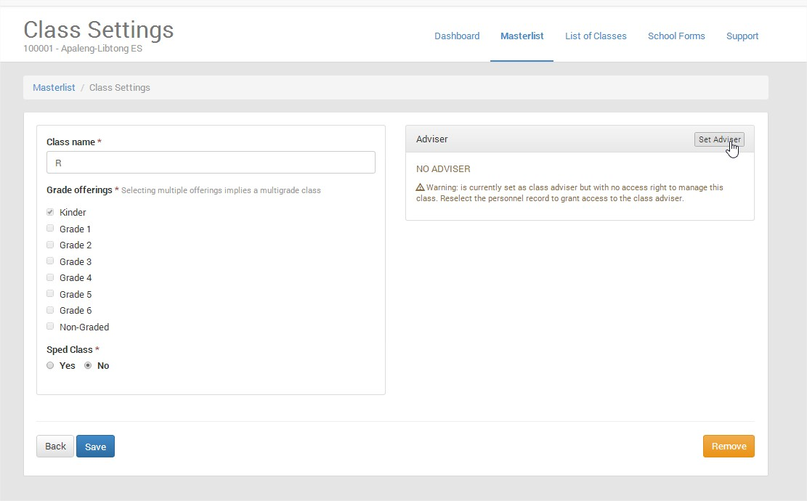
Click Set Adviser
By Alfredo Medrano, Planning Officer II-Ilocos Norte

Slide 44
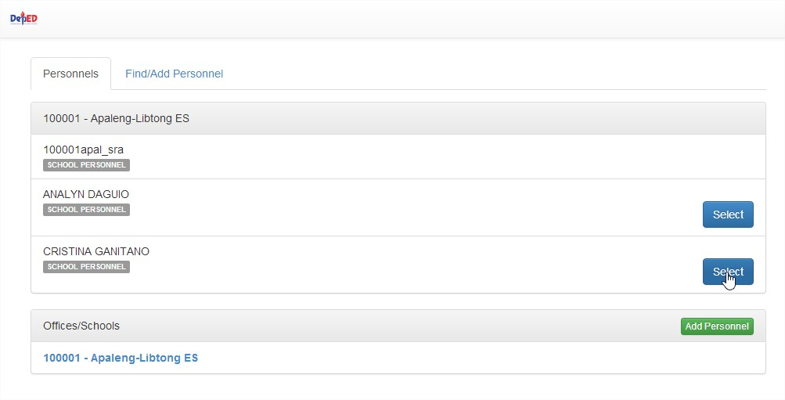
Select the Name of Adviser in the list, Click Select
By Alfredo Medrano, Planning Officer II-Ilocos Norte

Slide 45
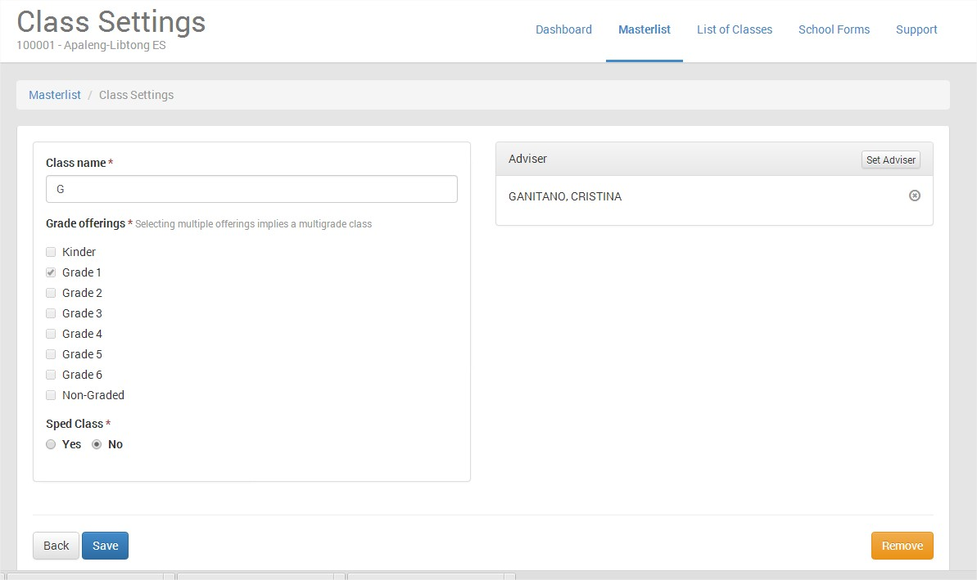
You can also edit the Class Name
Click Save after editing/setting an Adviser to save changes
By Alfredo Medrano, Planning Officer II-Ilocos Norte

Slide 46
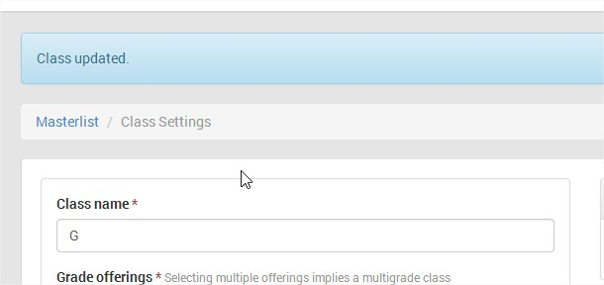
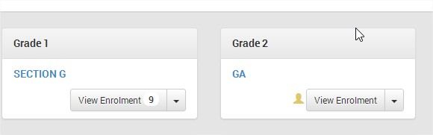
After saving, Class updated is displayed in the screen
With Adviser
With/out Adviser
In the List of Classes Menu, when you see like in the figure above, you can now determine if a class or section has no Adviser
End of Topic – Click Home
By Alfredo Medrano, Planning Officer II-Ilocos Norte

Slide 47
Click this ICON to return to TABLE OF CONTENTS
By Alfredo Medrano, Planning Officer II-Ilocos Norte

Slide 48
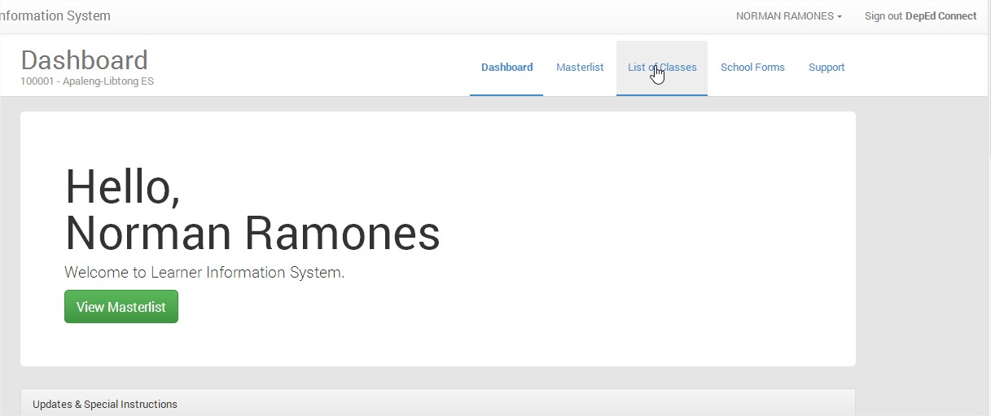
HOW TO SEARCH LEARNER WITH LRN
Click List of Classes
By Alfredo Medrano, Planning Officer II-Ilocos Norte

Slide 49
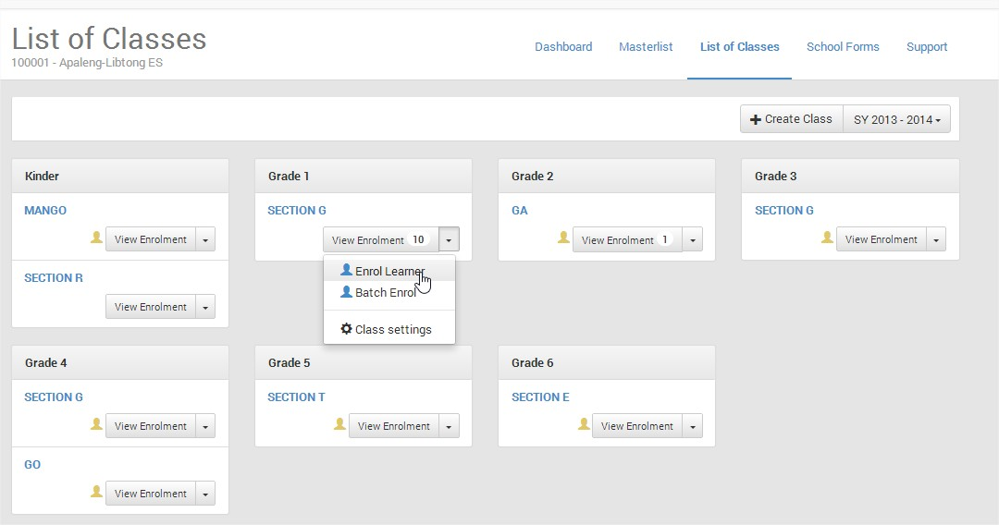
Pulldown Menu
Select any Grade and Section, use the pulldown menu, then click Enrol Learner
By Alfredo Medrano, Planning Officer II-Ilocos Norte

Slide 50
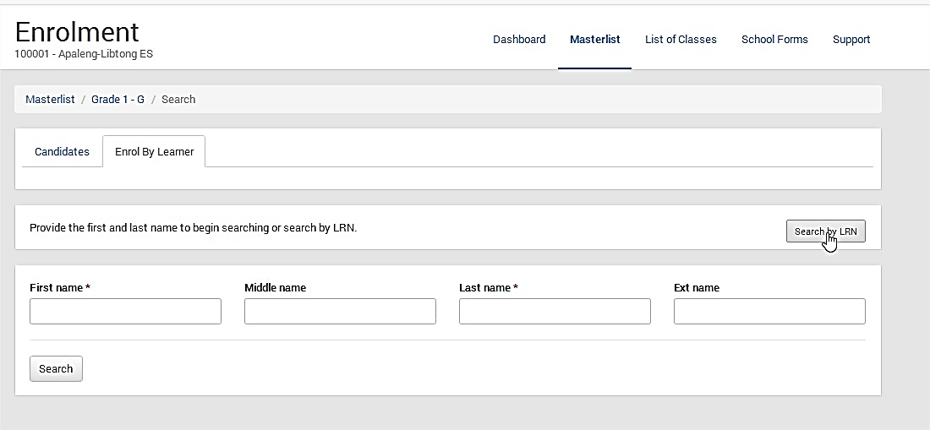
Click Search LRN
By Alfredo Medrano, Planning Officer II-Ilocos Norte

Slide 51
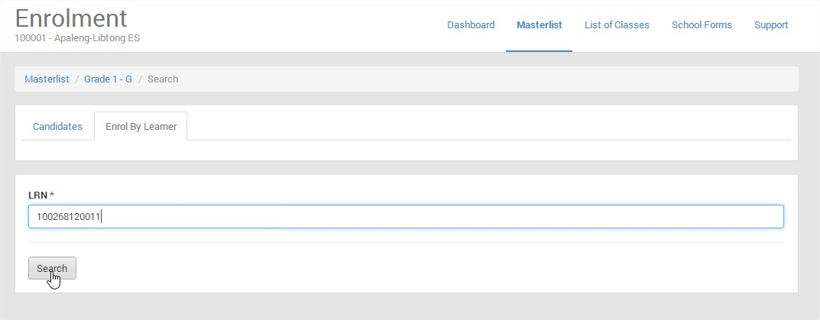
TYPE THE LRN OF PUPIL/STUDENT,
THEN CLICK SEARCH BUTTON
By Alfredo Medrano, Planning Officer II-Ilocos Norte

Slide 52
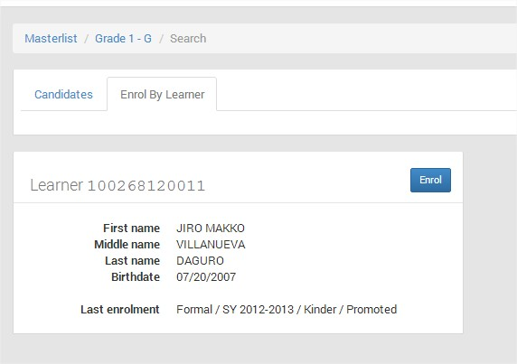
Click Enrol if you want to enroll
End of Topic – Click Home
By Alfredo Medrano, Planning Officer II-Ilocos Norte

Slide 53
Click this ICON to return to TABLE OF CONTENTS
By Alfredo Medrano, Planning Officer II-Ilocos Norte

Slide 54
HOW TO SEARCH LEARNER WITHOUT LRN
Click List of Classes
By Alfredo Medrano, Planning Officer II-Ilocos Norte

Slide 55
pulldown menu
Select any Grade and Section, use the pulldown menu, then click Enrol Learner
By Alfredo Medrano, Planning Officer II-Ilocos Norte

Slide 56
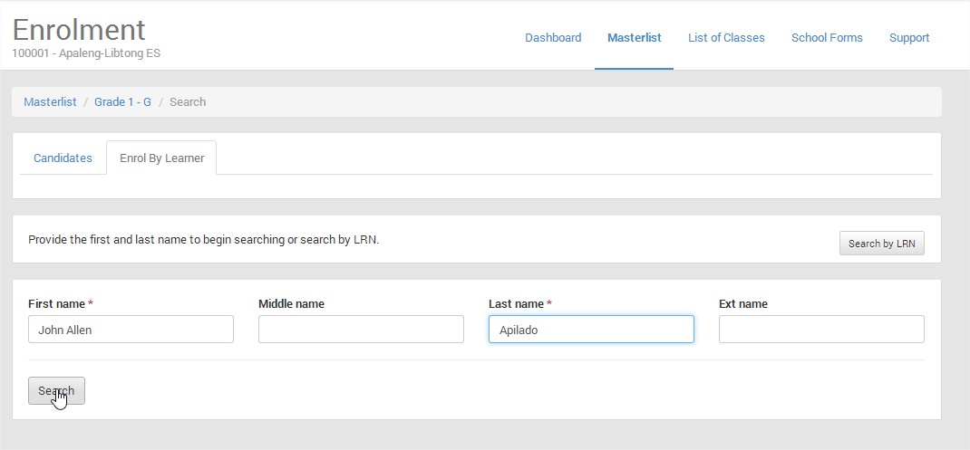
Type the First name and Last name, then click Search
By Alfredo Medrano, Planning Officer II-Ilocos Norte

Slide 57
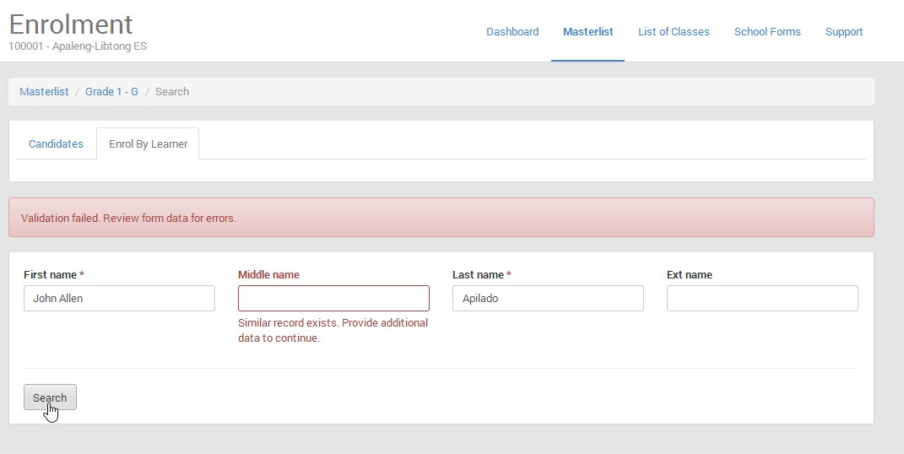
Type again the Middle Name, then Click Search
Note: As of March 2, if no middle name, type NA to continue
By Alfredo Medrano, Planning Officer II-Ilocos Norte

Slide 58
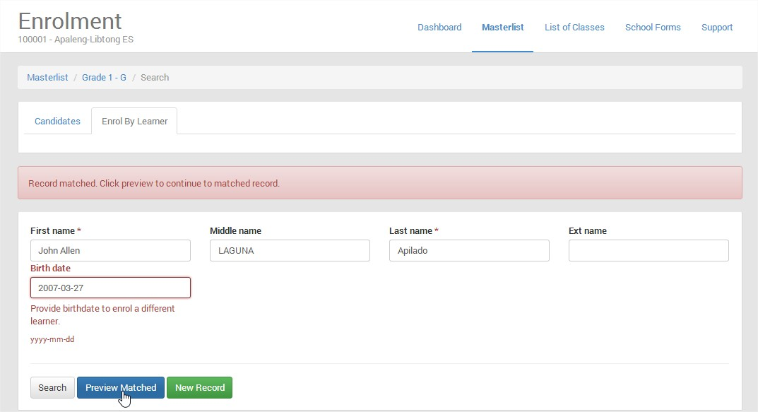
Type again the Birth date, then click Preview Matched to display the LRN and Enrolment History
By Alfredo Medrano, Planning Officer II-Ilocos Norte

Slide 59
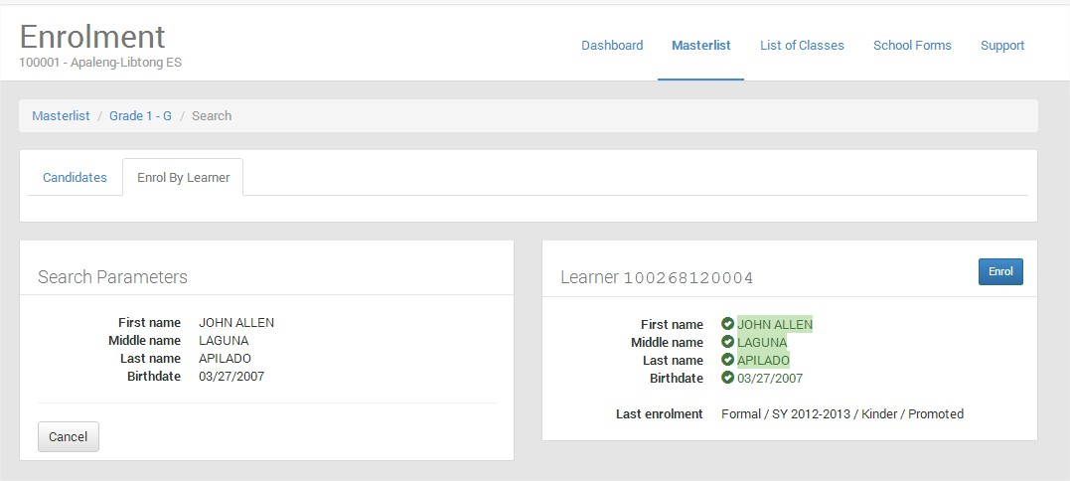
CLICK ENROL IF YOU WANT TO ENROLL
End of Topic – Click Home
By Alfredo Medrano, Planning Officer II-Ilocos Norte

Slide 60
Click this ICON to return to TABLE OF CONTENTS
By Alfredo Medrano, Planning Officer II-Ilocos Norte

Slide 61
CREATING LRN NUMBER OF PUPILS/STUDENTS AND ENROLLING THEM IN THE CURRENT SCHOOL YEAR
This facility is applied to all Kinder Pupils, pupils transferred from Private Schools, Balik Aral, students from Private Schools
In the list of Classes, select the Grade and Section you want to enrol the pupils without LRN
Click the pulldown menu, then select Enrol Learner
By Alfredo Medrano, Planning Officer II-Ilocos Norte

Slide 62
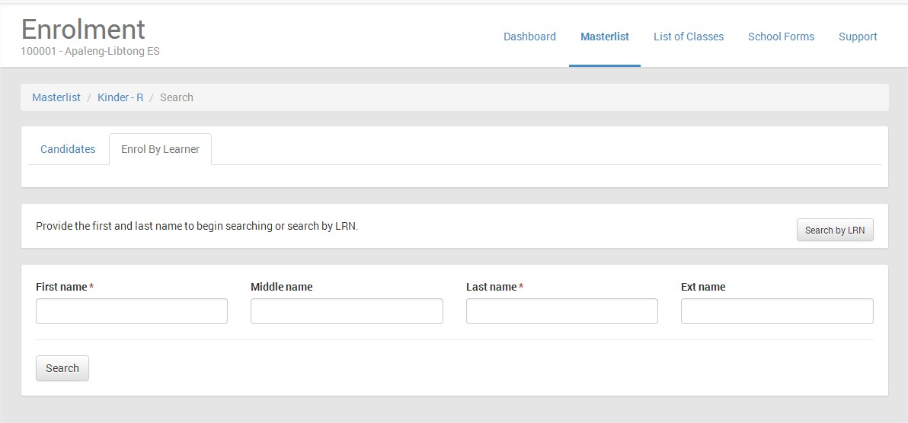
Type the First Name, Middle name and Last Name (with correct spelling), then click Search
By Alfredo Medrano, Planning Officer II-Ilocos Norte

Slide 63

CLICK NEW RECORD TO CREATE AN LRN
By Alfredo Medrano, Planning Officer II-Ilocos Norte

Slide 64

Click Complete Enrolment Record to Enter other details of pupils/students
By Alfredo Medrano, Planning Officer II-Ilocos Norte

Slide 65

Fill up the required information of the Pupils/ Students, then click Enrol to enroll and Create LRN
By Alfredo Medrano, Planning Officer II-Ilocos Norte

Slide 66

Click the List of Classes Menu, Click View Enrollment of the Grade and Section to display the LRN of pupils/Students enrolled in the current school year
By Alfredo Medrano, Planning Officer II-Ilocos Norte

Slide 67

End of Topic – Click Home
By Alfredo Medrano, Planning Officer II-Ilocos Norte

Slide 68
Click this ICON to return to TABLE OF CONTENTS
By Alfredo Medrano, Planning Officer II-Ilocos Norte

Slide 69

ENROLLING EXISTING PUPILS/STUDENTS IN THE PREVIOUS SCHOOL YEAR (NAKA-ENROLL PO LAST SCHOOL YEAR – ENCODED IN THE LIS SYSTEM VERSION 1 – Using Batch Enrolment)
Pulldown menu
Click List of Classes Menu, Select a Grade and Section you want to enroll pupils/students, then click the pulldown menu, then select Batch Enrol
By Alfredo Medrano, Planning Officer II-Ilocos Norte

Slide 70

Click the Box beside the number of the pupils, click Batch Enrol Selected
Note: You cannot include pupil/student with
Click here
By Alfredo Medrano, Planning Officer II-Ilocos Norte

Slide 71

Read this
After reviewing, click Batch Enrol Selected to enroll pupils/students in the current school year
By Alfredo Medrano, Planning Officer II-Ilocos Norte

Slide 72

Click List of Classes to view the list of classes
By Alfredo Medrano, Planning Officer II-Ilocos Norte

Slide 73

In the List of Classes, select a Grade and Section, then Click View Enrolment to display the current enrollment
By Alfredo Medrano, Planning Officer II-Ilocos Norte

Slide 74

End of Topic – Click Home
By Alfredo Medrano, Planning Officer II-Ilocos Norte

Slide 75
Click this ICON to return to TABLE OF CONTENTS
By Alfredo Medrano, Planning Officer II-Ilocos Norte

Slide 76

EDITING PROFILE OF PUPIL/STUDENT ENROLLED IN THE CURRENT SCHOOL YEAR
CLICK LIST OF CLASSES MENU, SELECT A GRADE OR SECTION YOU WANT TO EDIT, CLICK VIEW ENROLMENT
By Alfredo Medrano, Planning Officer II-Ilocos Norte

Slide 77

Select a pupil to edit, Click Profile
By Alfredo Medrano, Planning Officer II-Ilocos Norte

Slide 78

Click UPDATE
By Alfredo Medrano, Planning Officer II-Ilocos Norte

Slide 79

Edit the Profile like Religion, Dialect, Residence and others…, then Click Update.
Click Here to Enter Residence
By Alfredo Medrano, Planning Officer II-Ilocos Norte

Slide 80

Read this
Click List of Classes
By Alfredo Medrano, Planning Officer II-Ilocos Norte

Slide 81

End of Topic – Click Home
By Alfredo Medrano, Planning Officer II-Ilocos Norte

Slide 82
Click this ICON to return to TABLE OF CONTENTS
By Alfredo Medrano, Planning Officer II-Ilocos Norte

Slide 83
UN-ENROLL PUPILS/STUDENTS IN A CERTAIN
GRADE AND SECTION
In the List of Classes Menu, select a Grade and Section, Click View Enrolment
By Alfredo Medrano, Planning Officer II-Ilocos Norte

Slide 84

Select Pupil to remove in the list of enrolled, Click Un-enrol
By Alfredo Medrano, Planning Officer II-Ilocos Norte

Slide 85

Click OK to confirm Un-enrol
By Alfredo Medrano, Planning Officer II-Ilocos Norte

Slide 86

End of Topic – Click Home
By Alfredo Medrano, Planning Officer II-Ilocos Norte

Slide 87
Click this ICON to return to TABLE OF CONTENTS
By Alfredo Medrano, Planning Officer II-Ilocos Norte

Slide 88

ENROLMENT OF INDIVIDUAL PUPIL/STUDENT WITH Learner Basic Information is Incomplete
Click List of Classes Menu, Select a Grade and Section you want to enroll pupils/students, then click the pulldown menu, then select Batch Enrol
By Alfredo Medrano, Planning Officer II-Ilocos Norte

Slide 89

Select a pupil/ student with incomplete learner information or with triangle symbol, then Click Enrol at the right side beside Profile
By Alfredo Medrano, Planning Officer II-Ilocos Norte

Slide 90

Click Enrol
By Alfredo Medrano, Planning Officer II-Ilocos Norte

Slide 91

Fill up the required data *, then click Enrol
By Alfredo Medrano, Planning Officer II-Ilocos Norte

Slide 92

End of Topic – Click Home
By Alfredo Medrano, Planning Officer II-Ilocos Norte

Slide 93
Click this ICON to return to TABLE OF CONTENTS
By Alfredo Medrano, Planning Officer II-Ilocos Norte

Slide 94

PRINTING OF SCHOOL FORMS (SF1 AND SF5)
CLICK SCHOOL FORMS TO OPEN THE SCHOOL FORMS SCREEN
By Alfredo Medrano, Planning Officer II-Ilocos Norte

Slide 95

Select the Grade Level and Section using the pulldown menu to Print
By Alfredo Medrano, Planning Officer II-Ilocos Norte

Slide 96

Click HERE to download the School Form
End of Topic – Click Home
By Alfredo Medrano, Planning Officer II-Ilocos Norte

Slide 97
Click this ICON to return to TABLE OF CONTENTS
By Alfredo Medrano, Planning Officer II-Ilocos Norte

Slide 98

NOTE: IF YOU ARE USING GOOGLE CHROME, IT WILL AUTOMATICALLY DOWNLOAD THE FILE BELOW, IF YOU ARE USING MOZILLA FIRE FOX, IT WILL ASK YOU OPEN OR SAVE…….
Click Here to open
By Alfredo Medrano, Planning Officer II-Ilocos Norte

Slide 99

HOW TO CHANGE PASSWORD
Click HERE then select Settings
By Alfredo Medrano, Planning Officer II-Ilocos Norte

Slide 100

Type the Old Password, then type the New Password, then Repeat Password, Click Change Password
By Alfredo Medrano, Planning Officer II-Ilocos Norte

Slide 101

Read this
End of Topic – Click Home
By Alfredo Medrano, Planning Officer II-Ilocos Norte

Slide 102
Click this ICON to return to TABLE OF CONTENTS
By Alfredo Medrano, Planning Officer II-Ilocos Norte

Slide 103

RESET PASSWORD OF CLASS ADVISER
Click HERE, then Click Settings
By Alfredo Medrano, Planning Officer II-Ilocos Norte

Slide 104

CLICK PERSONNEL RECORD
By Alfredo Medrano, Planning Officer II-Ilocos Norte

Slide 105

CLICK MANAGE PERSONNEL
By Alfredo Medrano, Planning Officer II-Ilocos Norte

Slide 106

SELECT A PERSONNEL TO RESET PW, CLICK UPDATE
By Alfredo Medrano, Planning Officer II-Ilocos Norte

Slide 107

CLICK RESET PASSWORD
By Alfredo Medrano, Planning Officer II-Ilocos Norte

Slide 108

CLICK OK to confirm
By Alfredo Medrano, Planning Officer II-Ilocos Norte

Slide 109

Read this
End of Topic – Click Home
By Alfredo Medrano, Planning Officer II-Ilocos Norte

Slide 110
Click this ICON to return to TABLE OF CONTENTS
By Alfredo Medrano, Planning Officer II-Ilocos Norte

Slide 111
THANK YOU FOR LISTENING
By Alfredo Medrano, Planning Officer II-Ilocos Norte

