Slide 1
Performance Target Setting
For Private Schools

Slide 2
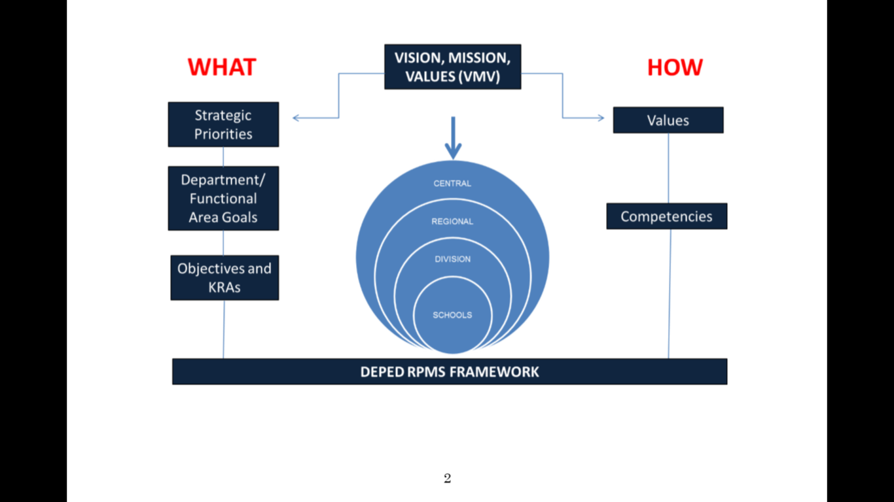
Strategic Directions
Values
School
Goals
Competencies
Performance
Indicators
Planning Framework

Slide 3
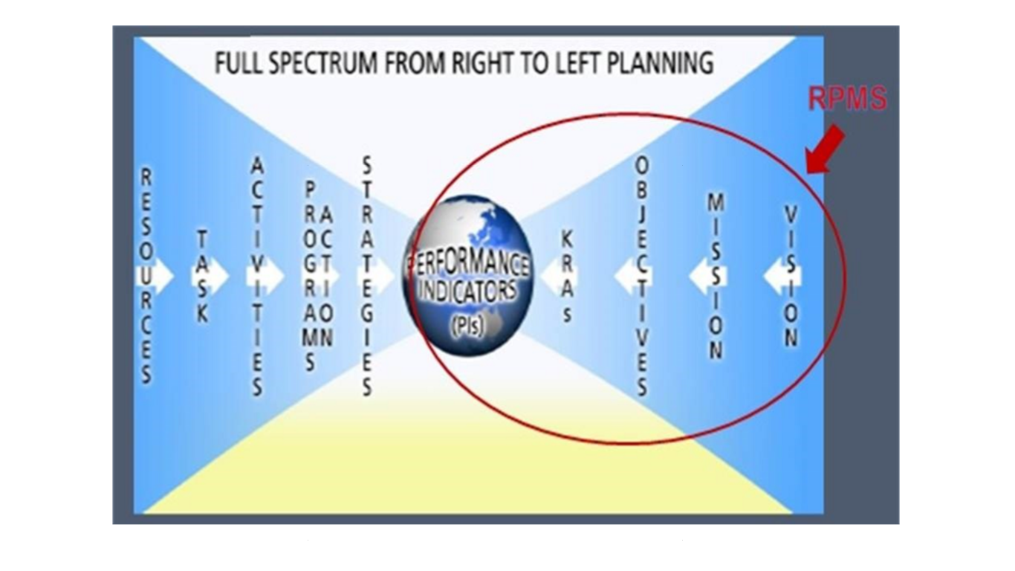

Slide 4
Performance Target Setting
Setting targets - NOT guessing
-Setting a target is not about guessing what you can achieve.
It involves knowing where you are now, what you are trying to achieve, and determining challenging interventions needed to get there

Slide 5
Performance Indicators in Basic Education
Access – Participation Rate/Enrolment
Efficiency – Holding power of Schools over
Children
Drop-out/School Leaver
Completion Rate
Cohort Survival Rate
Quality National Achievement Test-
Mean Percentage Score (MPS)

Slide 6
Performance Indicator for Quality: NAT-Mean Percentage Score
Grade 3
Subject | Public
Reading English | 38.92
Reading Filipino | 46.18
English Grammar | 38.20
Filipino Grammar | 43.51
Science | 40.36
Mathematics | 42.14
MPS | 41.74
Grade 6
Subject | SY 2011-2012
 | Public & Private | Public
Mathematics | 46.54 | 46.63
English | 53.66 | 50.60
Science | 52.64 | 50.98
Filipino | 61.30 | 61.17
Araling Panlipunan | 51.17 | 52.48
MPS | 53.06 | 52.37

Slide 7
NAT Secondary
Indicators | SY 2009-2010 | SY 2010-2011 | SY 2011-2012
Both Public and Private Schools | 45.80 | 59.9 | 48.81
Public Schools only | 2nd Yr 45.34 | 2ndYr 49.58 | 4th Yr 47.64

Slide 8
Performance Indicator: QUALITY
2014-15 Performance Targets by Learning Area
Learning Area | NAT-MPS 2012-2013 | NAT MPS 2013-2014 | Target NAT-MPS 2014-2015 | Interventions
Mathematics
Science
English
Filipino
Araling Panlipunan

Slide 9
What is Performance Management?
It is an organization-wide process to ensure that employees focus work efforts towards achieving the school’s Vision, Mission and goals
Performance Management is a systematic approach for continuous and consistent work improvement and individual growth.

Slide 10
Objectives of Performance Management System
1. Align individual roles and targets with school direction.
2. Track accomplishments against objectives to determine appropriate, corrective actions if needed.
3. Provide feedback on employees’ work progress and accomplishments based on clearly defined goals and objectives.
4. Become a tool for people development.

Slide 11
Sample Performance Indicators for Teachers
Sample Evaluation Form for Teachers

