Slide 1

National Inventory of DepEd
Public School Buildings Orientation
Notes:
Schedule of the Orientations
November 7, 2014 Regions VI, VII, VIII Ecotech, Cebu (Annex)
November 7, 2014 Regions IX, XII, ARMM Ecotech, Cebu (2nd flr)
November 10, 2014 Regions I, II, III, CAR RELC, Pampanga
November 10, 2014 Regions IV-A, IV-B, V, NCR RELC, Batangas
November 11, 2014 Regions X, XI, Caraga RELC, Cagayan de Oro
Agenda:
Briefing of Rationale, Objectives and Process Flow
Discussion of the Inventory Form and Definition of Terms
Orientation on the online encoding facility in the EBEIS
Focus Group Discussion on Pre-Work

Slide 2
Rationale
Schools submit enrolment and inventory data in the EBEIS.
Classroom requirements and shortages are computed.
Classroom allocation is formulated.
Classrooms are built.
DepEd continues to work towards making all schools child-friendly, safe and conducive to learning.
Part of this effort is providing the appropriate facilities for each school based on data collected from our schools and standards set by policymakers.
We want to understand:
What do our schools have? (Inventory)
What do our schools need? (Requirements)
What should we provide?
(Allocation)
Getting the accurate inventory is essential in this process.

Slide 3
Objective
Establish accurate and comprehensive baseline data of school buildings in all DepEd public schools for use in
Planning, budgeting and decision making
Annual updating in subsequent years

Slide 4
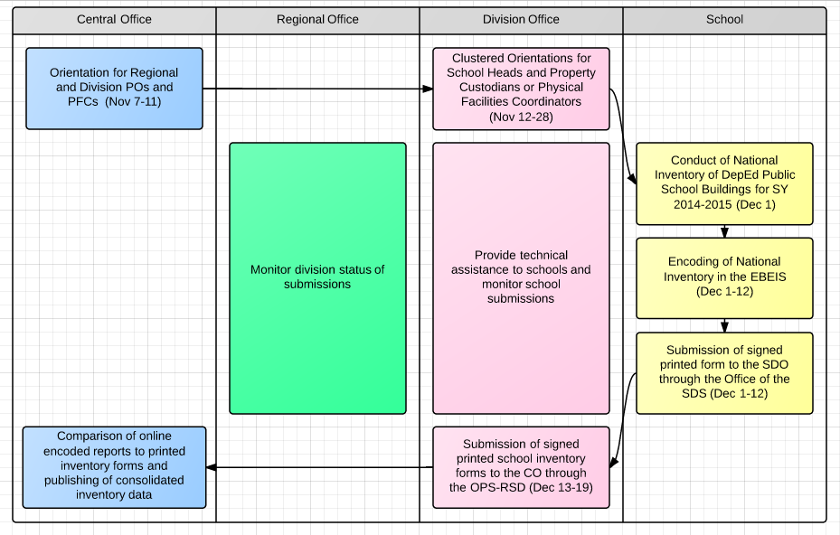
Process Flow
Notes:
General Process Flow of the Conduct of the National Inventory
Note re encoding in the EBEIS, use ebeis.deped.gov.ph. Do not encode in the test site.

Slide 5
School guidelines for conduct of inventory

Slide 6
Officials in Charge
School Head
with assistance from
either the
School Property
Custodian
or the
Physical Facilities
Coordinator
either the
PTA President
or the
Kagawad
in charge of education
and

Slide 7
Site Development Plan
How do you visualize it?
What can you see?
Where
do you see it?
Site Development Plan
Notes:
Emphasize necessity of a Site Development Plan before conduct of the inventory.
If they already have one, review and update.
If they do not have one yet, make one.

Slide 8
Site Development Plan
How do you visualize it?
What can you see?
Where
do you see it?
Site Development Plan
What can you see?
Identify all existing buildings, rooms and facilities in the school site regardless of present condition.
For buildings and rooms:
How many are present in the school?
What are the types of each building?
How many rooms are there in each building?
Against what fund source were they charged against?

Slide 9
Site Development Plan
How do you visualize it?
What can you see?
Where
do you see it?
Site Development Plan
Where do you see it?
Identify locations (not necessarily exact location-scale) of all buildings, rooms and other facilities existing in the school.
Assign numbers to each of the existing buildings and rooms for every building.

Slide 10
Site Development Plan
How do you visualize it?
What can you see?
Where
do you see it?
Site Development Plan
How do you visualize it?
Map all buildings, rooms and facilities and ensure proper labeling of each.
Facing the school, start from the main gate turning left then straight to the first facility or building seen.
Refer to the diagram for visual representation.

Slide 11
Site Development Plan
SAMPLE SITE DEVELOPMENT PLAN (as of 30 November 2014)
Gate
4
Covered Court
3
Building 3
(Bagong Lipunan Type)
2
1
Makeshift Room 1
4
3
Building 2
(Marcos Type)
4
3
2
1
first floor
2
8
7
6
5
second floor
1
Building 1
(DepEd School Building (Standard))
Comfort Room

Slide 12
Site Development Plan
SAMPLE SITE DEVELOPMENT PLAN (as of 30 November 2014)
Gate
4
Covered Court
3
Building 3
(Bagong Lipunan Type)
2
1
Makeshift Room 1
4
3
Building 2
(Marcos Type)
4
3
2
1
first floor
2
8
7
6
5
second floor
1
Building 1
(DepEd School Building (Standard))
)
Comfort Room
Notes:
Stress that the direction of counting buildings and classrooms must always be from left to right (clockwise).

Slide 13
School Building Inventory Form
Table 1. Existing School Buildings
Building Number
Building Type and
Room Dimension
Actual Building Condition
Number of rooms per floor per school building
Funding Source
Name of Contractor and Year of Completion (optional)
If the building type, room dimension, building condition and funding sources
are not included in the list of choices, please specify accordingly.
Notes:
Building Number
refers to a number specifically tagged to a specific building in a school
Building Type
refers to the design of a school building (e.g. Gabaldon, Marcos Pre-Fab, ESF, TEEP, SEDIP, etc.)
Room Dimension
refers to the size of a room specifying the width and length (WxL).
Width refers to the side of the chalkboard while length refers to the side of the window.
Though there are standard room sizes for each school building type, there may have been modifications during construction. The actual constructed room size should be specified.
If there are multiple room sizes in one building, indicate the size that occurs in the most number of rooms.
Building Condition
refers to the current physical state of a building or room.
Choices include Good, Needs Minor Repair, Needs Major Repair and Condemned.
Number of rooms per floor per school building
refers to the total number of rooms located for each floor of a specific building
Numbering will start from left to right for all buildings.
Funding Source
- refers to the source of budget for construction of buildings and rooms

Slide 14
School Building Inventory Form
Building Type | Room Dimension (WxL)
Aqua-Culture NC II Building | 10x19
Army Type School Building
Automotive Servicing NC II Building | 10x29
Bagong Lipunan School Building (BLSB) Type I | 6x8
Bagong Lipunan School Building (BLSB) Type II | 8x6
Bagong Lipunan School Building (BLSB) Type III | 8x6
Beauty Care NC II Building | 7x16
Carpentry NC II Building | 10x27
Commercial Cooking NC II Building | 10x16
Consumer Electronic Technician NC II Building | 10x16
DepED School Building (Modified) | 7x7
DepED School Building (Standard) | 7x9
Building Type and
Room Dimension

Slide 15
School Building Inventory Form
Building Type | Room Dimension (WxL)
DOST Science Laboratory Building
DPWH-BOD Building
Dress Making NC II Building | 10x16
Economic Support Fund (ESF)
Educational Facilities Improvement Program (EFIP) – JICA
Electrical Installation Maintenance NC II Building | 10x25.6
Federation of Filipino Chinese Chamber of Commerce and Industry, Inc. (FFCCCII) | 7x7 and 7x9
Food Processing NC II Building | 10x16
FVR 2000 Building
Gabaldon Type
Government of Spain-Spanish Grant School Building
Building Type and
Room Dimension

Slide 16
School Building Inventory Form
Building Type | Room Dimension (WxL)
Home Economics Building | 7x9
Imelda Type
Industrial Arts Building | 7x18
Learning and Public Use Schoolbuilding (LAPUS) | 7x27
Little Red School House
Magsaysay Type
Marcos Pre-Fabricated School Building | 7.5x6
Multi-Purpose Workshop Building | 7x18
PAGCOR School Building | 7x9
Pre-School/Kindergarten Building | 7x9
Public-Private School Infrastructure Project (PSIP School Building) | 7x9
Readily Assembled Multi-Option Shelter (RAMOS) Type
Building Type and
Room Dimension

Slide 17
School Building Inventory Form
Building Type | Room Dimension (WxL)
RP-US Bayanihan Type | 8x6
SBP4BE Building - AusAid | 7x9
Science Laboratory Building | 7x18
Secondary Education Development Improvement Program (SEDIP) | 7x9
Secondary Education Development Program (SEDP)
Shielded Metal Arc Welding NC II Building | 10x16
SPHERE Building - AusAid | 7x9
Third Elementary Education Project (TEEP) Building | 7x18
Typhoon Resistant School Building Program (TRSBP) - JICA
Others (not in the list)
Building Type and
Room Dimension

Slide 18
School Building Inventory Form
Building Condition | Definition
Good | refers to a building which does not need repair
Needs Minor Repair | refers to the repair or replacement of school building components which are not subjected to critical structural loads and stresses and which are estimated to cost less than ten percent (10%) of the cost of a standard building unit such as repair of windows, doors, partitions and the like.
Needs Major Repair | refers to the repair or replacement of school building components which are subjected to critical structural loads and stresses and which are estimated to cost ten percent (10%) or more of the cost of a standard building unit such as roof frames, posts and exterior walls.
Condemned | refers to a building officially declared by the Municipal Engineer to be dangerous to the life, health, property or safety of the public or its occupants.
Actual Building Condition
Notes:
Minor repair
Can usually be repaired using MOOE funds
Repairs that can be covered by P100,000
Major Repair
- Repairs that cost more than P100,000

Slide 19
School Building Inventory Form
Funding Source | Definition
DepEd budget | refers to a building or room funded by the DepEd National Budget whether implemented by DepEd or DPWH. (e.g. Basic Education Facilities Fund, Regular School Building Program, Public-Private Partnership School Infrastructure Program)
DepEd with counterpart fund | refers to a building or room constructed using DepEd funds with counterpart of at least 10% from other sources.
LGU/SEF | refers to a building or room funded from the Special Education Fund (SEF) and the budgets of Local Government Units (LGU): provincial, municipal or barangay units.
Congress | refers to a building or room funded from the initiatives from members of the House of Representatives and the Senate of the Philippines.
PTA-funded | refers to a building or room funded by the Parents-Teachers Association (PTA).
Local private sector | refers to a building or room funded from donations of Philippine-based private individuals, corporations, alumni associations, non-government organizations and philanthropic organizations.
Foreign fund/donor | refers to a building or room funded from foreign-assisted projects and bilateral agreements with donor countries.
Funding Source

Slide 20
School Building Inventory Form
Table 2. Existing Rooms
Building Number
Room Number
Room Condition
Actual Usage
Notes:
Building Number
refers to a number specifically tagged to a specific building in a school
Room Number
refers to a number specifically tagged to a specific room in a specific building
Different from total number of rooms per floor in Table 1.
The room numbers must always start with 1 in each building and the count continues up to the last room in the last floor of the same building.
Actual usage
refers to the manner by which a room is currently being utilized
One room may have multiple usage (choose all applicable uses)

Slide 21
School Building Inventory Form
Room Condition | Definition
Good | refers to a room which does not need repair
Needs Minor Repair | refers to the repair or replacement of school building components which are not subjected to critical structural loads and stresses and which are estimated to cost less than ten percent (10%) of the cost of a standard building unit such as repair of windows, doors, partitions and the like.
Needs Major Repair | refers to the repair or replacement of school building components which are subjected to critical structural loads and stresses and which are estimated to cost ten percent (10%) or more of the cost of a standard building unit such as roof frames, posts and exterior walls.
Condemned | refers to a room officially declared by the Municipal Engineer to be dangerous to the life, health, property or safety of the public or its occupants.
Room Condition
Notes:
Minor repair
Can usually be repaired using MOOE funds
Repairs that can be covered by P100,000 and below
Major Repair
- Repairs that cost more than P100,000

Slide 22
School Building Inventory Form
Actual Usage
Classroom (Kindergarten) | Guidance Office
Classroom (SPED) | Home Economics Laboratory
Classroom (Elementary) | Industrial Arts Laboratory
Classroom (Secondary) | Library
Audio-Visual Room | Multi-Purpose Hall
Canteen | Principal's Office
Clinic | Speech Laboratory
Computer Room | Supply Room
Conference Room | Others (Please specify)
District Supervisor's Office | Not Currently Used
Faculty Room
Actual Usage
Notes:
Actual usage
refers to the manner by which a room is currently being utilized
One room may have multiple usage (choose all applicable uses)

Slide 23
School Building Inventory Form
Table 3. Existing Makeshift Rooms
Makeshift Room
refers to a separate temporary structure which is used either as a means of easing up classroom shortage or as a temporary learning space during emergencies.
Room Number
Actual Usage
Notes:
Makeshift Room
Should not be part of an existing building (e.g. rooms under the stairs and in the corridor)
Rooms under stairs and corridors turned into classrooms are NOT considered makeshift rooms
Room Number
refers to a number specifically tagged to a specific makeshift room
Actual usage
refers to the manner by which a room is currently being utilized
One room may have multiple usage (choose all applicable uses)

Slide 24
School Building Inventory Form
Actual Usage
Classroom (Kindergarten) | Guidance Office
Classroom (SPED) | Home Economics Laboratory
Classroom (Elementary) | Industrial Arts Laboratory
Classroom (Secondary) | Library
Audio-Visual Room | Multi-Purpose Hall
Canteen | Principal's Office
Clinic | Speech Laboratory
Computer Room | Supply Room
Conference Room | Others (Please specify)
District Supervisor's Office | None
Faculty Room
Actual Usage
Notes:
Actual usage
refers to the manner by which a room is currently being utilized
Drop down list in the online facility
One room may have multiple usage (choose all applicable uses)

Slide 25
School Building Inventory Form
Table 4. Existing Functional and Usable Facilities
Toilet Bowls
refer to toilet bowls in the school, whether inside or outside the classroom
Urinals
refer to individual urinals and troughs in the school, whether inside or outside the classroom
*Quantity – refers to the total number of facilities in the school

Slide 26
School Building Inventory Form
Table 4. Existing Functional and Usable Facilities
Armchairs
refer to armchairs used by learners in the school, regardless of material (wood, plastic)
Chairs
refer to usable chairs, with a backrest but no arm table attached in the school, regardless of material (wood, plastic) excluding teachers' and personnel's chairs inside the classroom and in offices
*Quantity – refers to the total number of facilities in the school

Slide 27
School Building Inventory Form
Table 4. Existing Functional and Usable Facilities
School Desks
refer to usable two-seater desks in the school
Washing Facilities
refer to functional faucets and water pumps (poso) in the school, whether inside or outside comfort rooms
*Quantity – refers to the total number of facilities in the school

Slide 28
School Building Inventory Form
Table 5. Existing Other Structures
Auditorium or Gymnasium
an enclosed hall or building used for public gatherings
Concrete Quadrangle
a multi-purpose open space for school activities
Covered Court
a covered rectangular area intended for basketball games but used for various purposes
Notes:
Note:
Do not include ongoing construction of other structures
Must be present inside the campus

Slide 29
School Building Inventory Form
Table 5. Existing Other Structures
Entrance Gate
a barrier used as an entrance and exit of the school, which can be closed and locked beyond school hours
Gazebo
a roofed structure with seats that allows for an open view of surrounding areas
Perimeter Fence
a barrier, railing or structure that surrounds the entire school property
Notes:
Note:
Do not include ongoing construction of other structures
Must be present inside the campus

Slide 30
School Building Inventory Form
Table 5. Existing Other Structures
Playground
an outdoor area specifically provided for learners to play on
School Garden
an area used for growing plants
School Stage
a raised platform where programs are usually held
Notes:
Note:
Do not include ongoing construction of other structures
Must be present inside the campus

