Slide 1
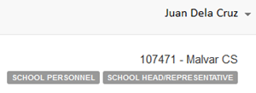
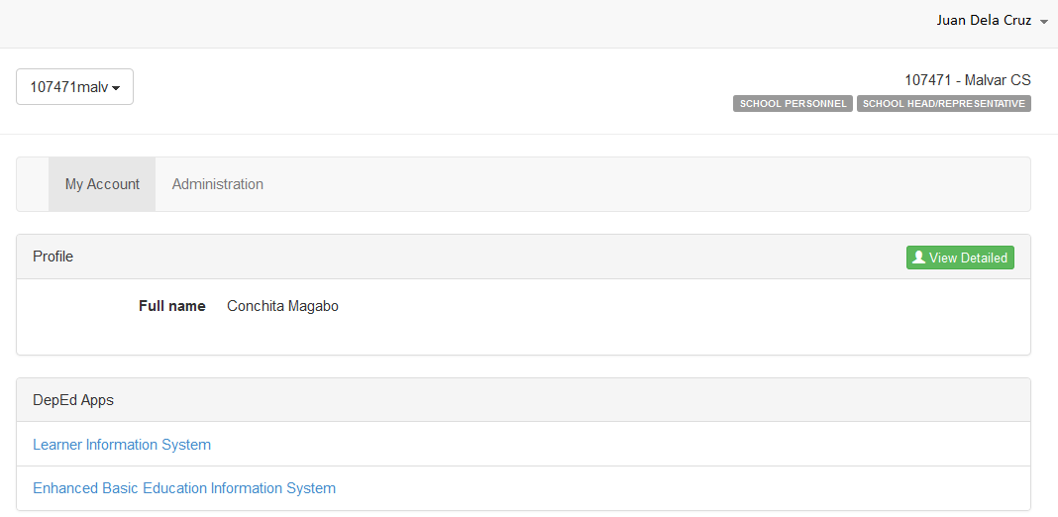
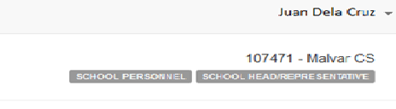
Log in the EBEIS using a School Head / Representative Account

Slide 2
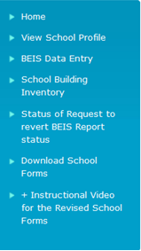
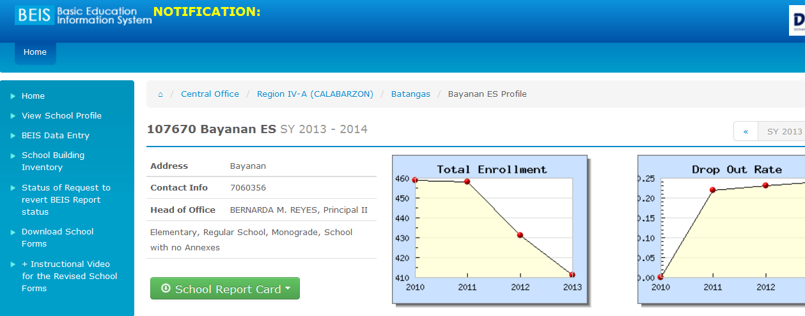
Click School Building Inventory at the Main Menu Panel

Slide 3
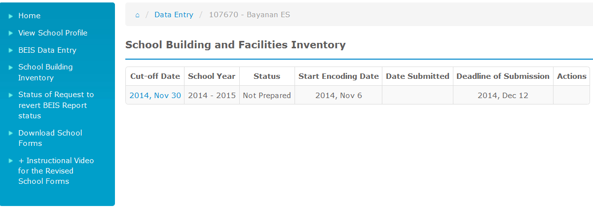
At the School Building Facilities Inventory Main page, report parameters are displayed
Click on the Cutoff Date link to encode or view inventory page

Slide 4
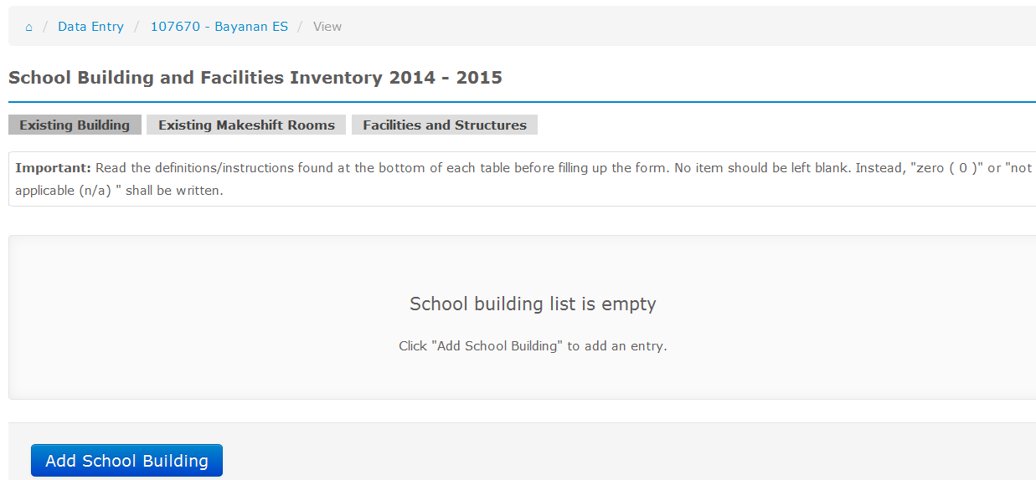
On first entry, the message “School building list is empty” is displayed
Click Add School Building to encode data

Slide 5
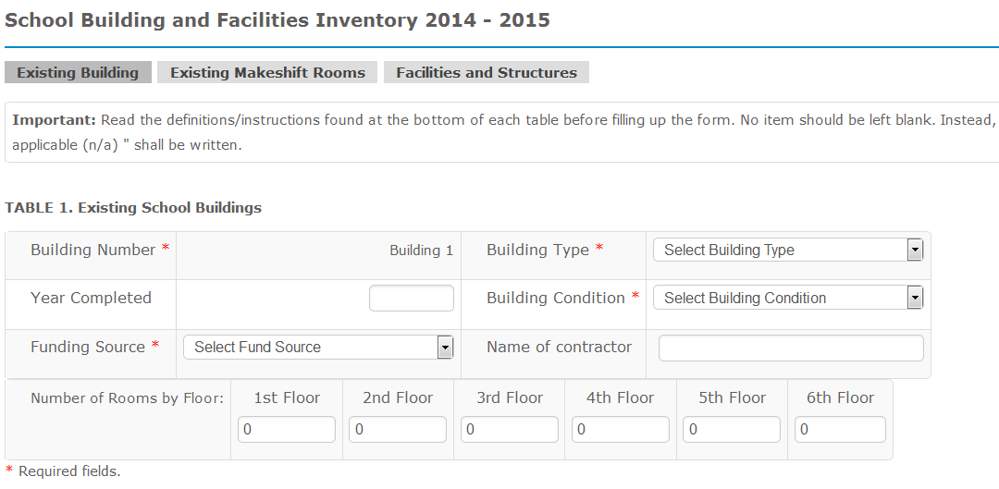
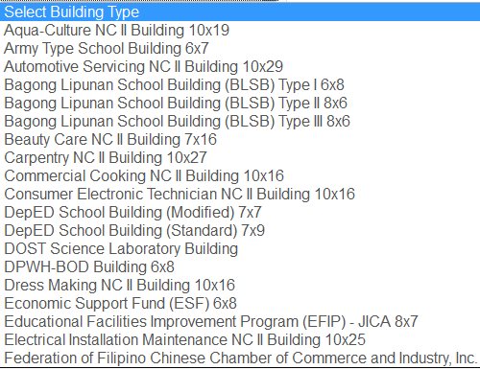
Data entry page for School Buildings
Ctrl+LeftClick to select more than one type

Slide 6
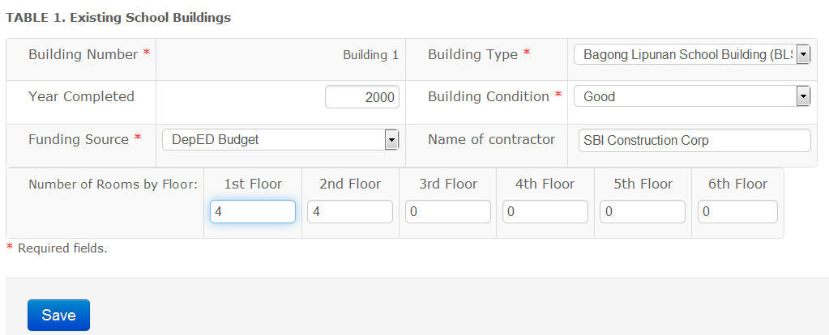
Save School Building data before encoding rooms

Slide 7
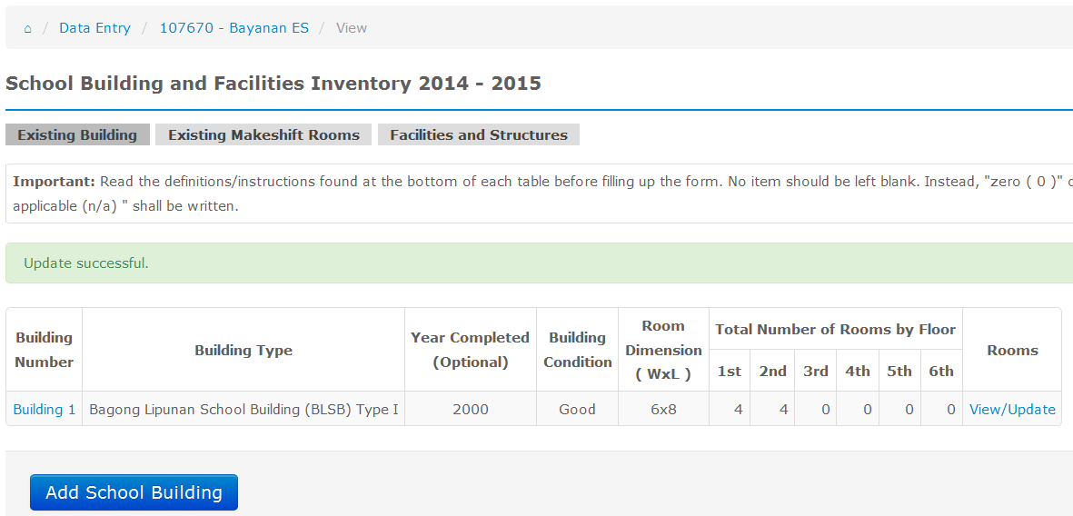
View School Buildings Inventory page
Click View/Update to encode room inventory per building

Slide 8
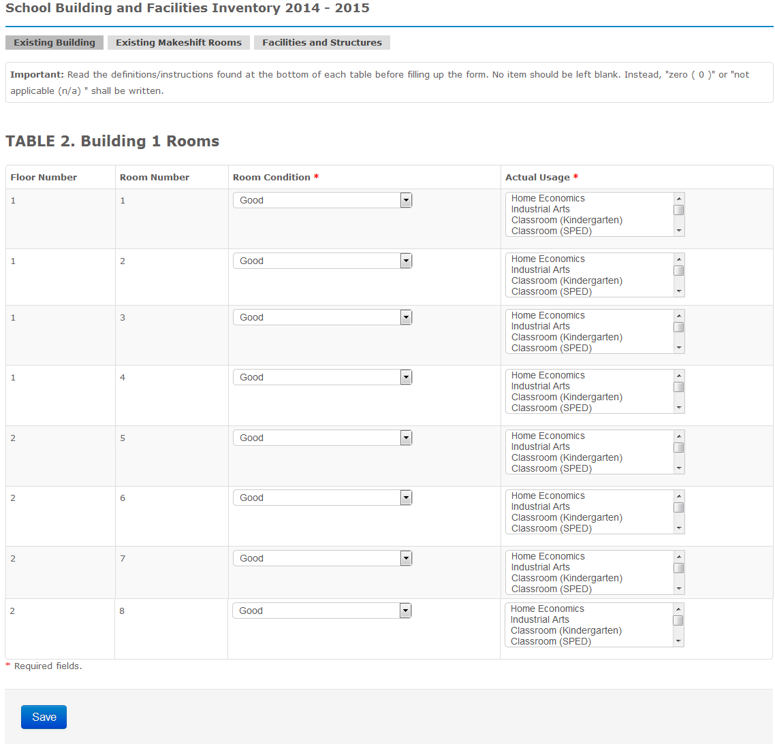
Auto Room Number
1
8

Slide 9
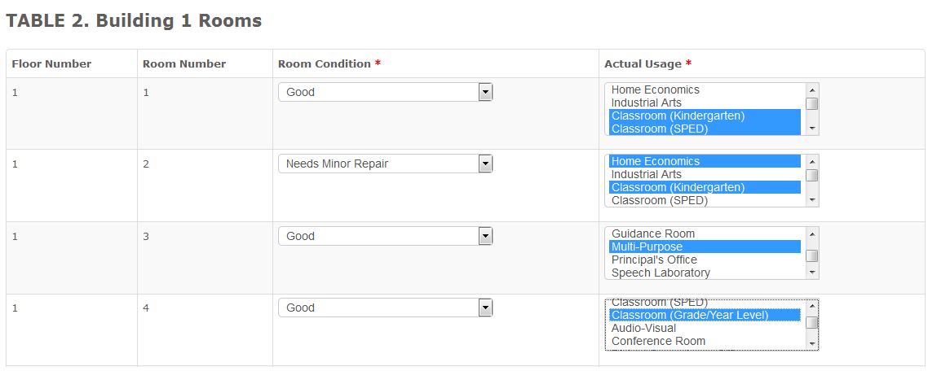
Update Rooms Inventory page
Ctrl+Left Click for multiple selection

Slide 10
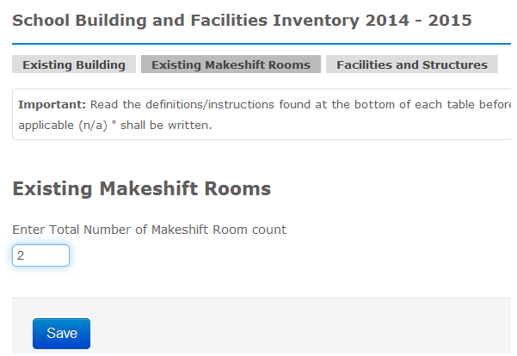
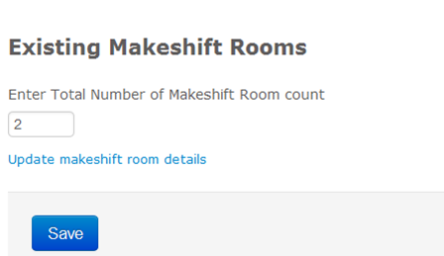
Click Existing Makeshift Rooms tab
Enter no. of makeshift rooms then Save
Click to update makeshift room details

Slide 11
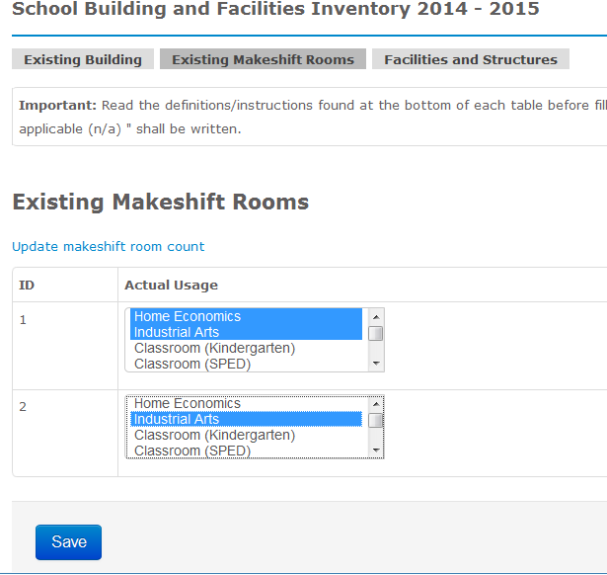
Makeshift Rooms Update page

Slide 12
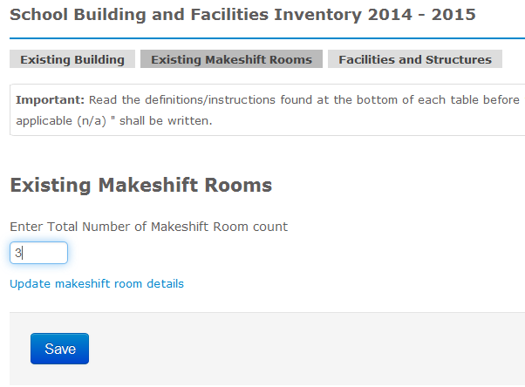
Makeshift Rooms Update page
To add, reduce or correct the number of makeshift rooms, update total number first

Slide 13
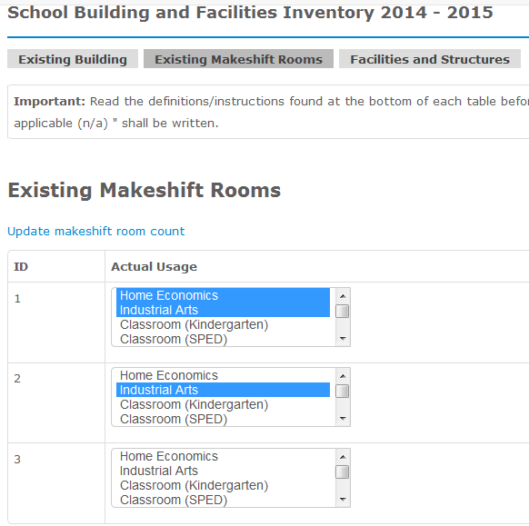
Makeshift Rooms Update page
No. of makeshift rooms is automatically updated

Slide 14
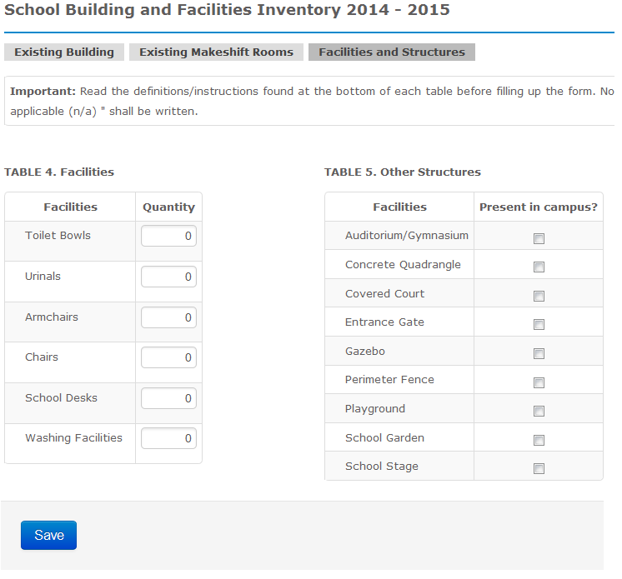
Other Facilities & Structures Update page

Slide 15
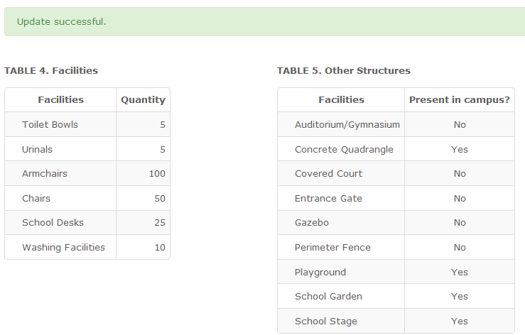
Other Facilities & Structures Update page

