Slide 1


The 2015 NCAE
Test Administration Guidelines
National Education Testing and Research Center
Department of Education

Slide 2
Acronyms
SDS -Schools Division Superintendent
DTC -Division Testing Coordinator
PSS -Private School Supervisor
SH -School Head
STC -School Testing Coordinator
CE -Chief Examiner
RS -Room Supervisor
RE -Room Examiner
LRN -Learner Reference Number
TMs -Test Materials
TB -Test Booklet
SAS -Scannable Answer Sheet
EH -Examiner’s Handbook
SSH -Scannable School Header
ETRE -Examiner’s Transmittal Report Envelope
CETRE -Chief Examiner’s Transmittal Report Envelope
COR -Certificate of Rating

Slide 3
Responsibilities of the Testing Staff

Slide 4
Roles of the Regional Testing Coordinator (RTC) in the Conduct of the NCAE and NAT
Attends the national conference on the administration of the NCAE and NAT for awareness of standardized test guidelines and procedures as one of the end-users of the test results.
Serves as the resource person relative to the official list of private schools operating without permit.
Clarifies issues and concerns relative to the Philippine Validating Test (PVT) for which the Regional Office is directly concerned (e.g. endorsement to NETRC)

Slide 5
The Testing Staff at the Division Level
Division Level
SDS*
DTC
PSS
School Level
School Head/ Chief Examiner
School Testing Coordinator
Room Supervisors
RE ₁
RE ₂
RE ₃
RE ₄
RE _{n}
*Assignment of the testing staff shall be done by the SDS.

Slide 6
Schemes in the Assignment of Room Examiners
1
Swapping of teachers in public and private schools
2
For divisions with only few public and private high schools, elementary school teachers from public schools may serve as REs.
3
Teachers from big public schools may be dispersed in small private schools.
4
Other public school teachers from the other districts may serve as RE when there is insufficiency of private school teachers.
Public
Private
Public Elem
Schools with insufficient REs
Big public
Small private (many)
Other districts
District with Insufficient REs

Slide 7
The Schools Division Superintendent (SDS) shall:
The Testing Staff and Their Roles
1. be responsible for the smooth conduct of the test in the division
2. assign one of the division supervisors as Division Testing Coordinator
4. remind PSS to manage tardiness of some private school teachers on examination day.
3. designate Room Examiners who are reliable, competent, experienced in the conduct of NCAE and have no history of lost Test Booklets (TBs)

Slide 8
The Division Testing Coordinator
Prepares accurately, with the assistance of PSS, the enrolment data using the prescribed format and corresponding guidelines.
On behalf of the SDS, the DTC chooses REs who are credible, trustworthy and with testing experience.
Orients the SHs or STCs prior to test administration.
Maintains the security and confidentiality of test materials received from the NETRC through a courier. Issues an Oath of Confidentiality for the SHs on this regard.
Examines the packing guide of TMs upon receipt.
Notifies NETRC on the condition of TMs received.
Accounts all the TMs before final packing.

Slide 9
The Private School Supervisor
Disseminates information regarding the NCAE and DepED’s latest issuances on it to private schools in the division.
Coordinates with private school principals regarding the conduct of the exam to its target clientele; formulates an agreement with the SH regarding proper test administration.
Checks closely if private schools operating without permit were included vis-à-vis the official list from the region. The said schools should be excluded. Likewise, make sure schools with permit are still operating.
Prepares and provides the DTC with the enrolment data on private schools to be tested, which will be used in the budget preparation and submitted to NETRC for the preparation of TMs.
Assists the DTC in the echo-orientation in the Division Level for private schools.*
Closely supervises the delivery and retrieval of TMs on testing day and assists the DTC in the accounting of TMs.
Oversees the conduct of the test in private schools.
*No extra funding from NETRC is provided for this activity.

Slide 10
The Chief Examiner – School Head of the Testing Center
Maintains the security and confidentiality of test materials received from the DTC after getting the TMs from the DTC (test boxes are opened on Examination Day);
Accountable and responsible for all TMs received. This ends when the TMs are returned to the DTC;
Assigns a room where all REs can be met before and after the test administration (distribution room);
Counts all packs of TBs and/or ASs before releasing them to each RE;
Records pertinent data about the test materials released to and received from the REs in the Accounting Form (Form 3) and Forms 4, 5, 6 and in the SSH;

Slide 11
The Chief Examiner – School Head of the Testing Center
Distributes the TBs to each RE and reminds him/her to count these without opening the pack and before leaving the room;
Reminds each RE that the ETRE’s are sealed in the Examination Room before proceeding to the Distribution Room for the retrieval phase;
Monitors proper accomplishment of the different forms by the RE while the test proper is in progress;
Follows the instruction for Accounting and Packing of TMs found at the latter part of the EH;
Aware of the details of the testing program to be administered; and
Orients every teacher in his/her respective school on the guidelines and EH relative to the test administration.

Slide 12
The Room Examiner
Counts the TBs and ASs without opening the plastic bags containing them before proceeding to his/her assigned testing room. Any discrepancy should be acted upon immediately and this should be reported in the CE’s Report.
Signs Form 3 as he/she receives the TMs from the CE/STC while still in the distribution room.
Checks if the examinees have lead pencils to use and a sheet of blank paper for computation purposes;
Facilitates the recording of the Examinee Number and Test Booklet Number of the Examinees in the NETRC Form 2 (Seat Plan);

Slide 13
Supervises closely the shading of bubbles in the AS for the non-test items;
Follows strictly the EH during test administration;
Keeps custody of all the used and unused TBs but are not allowed to read the contents; otherwise, he/she will be given corresponding sanctions based on DECS Order No. 85, s. 1999;
Checks the contents of the ETRE before he/she seals it while still in the examination room; and
Accomplishes Form 7.

Slide 14
The Room Supervisor
Monitors the conduct of the test administration in a testing center with 5 or more testing rooms (NCAE).
Checks if the REs adhere to the instructions in the EH.
Collects all unused SAS from every RE at the time when the examinees are answering the last subtest in the morning session and to indicate in Form 3 the serial numbers of unused Test Booklets and Answer Sheets.
Counts and double counts the TBs per pack and the number of ETREs.
Notes:
The RS must come from another school other than those schools where REs shall be assigned.
The number of RSs assigned in a testing center will depend on the number of examinees in an examination room.
Below is the ratio:
1 RS is assigned in every 10 rooms if there are 20 examinees/room (LAPG / PEPT)
1 RS is assigned in every 5 rooms if there are 30 examinees/room (NAT / NCAE)

Slide 15
The School Testing Coordinator
Double checks the enrolment data of the school prior to submission to the DTC.
Attends the orientation at the division level in the absence/in behalf of the SH.
Accomplishes the SSH.
Assists the CE in all the testing activities.
Double checks the TMs before final packing, being accountable also on these materials.

Slide 16
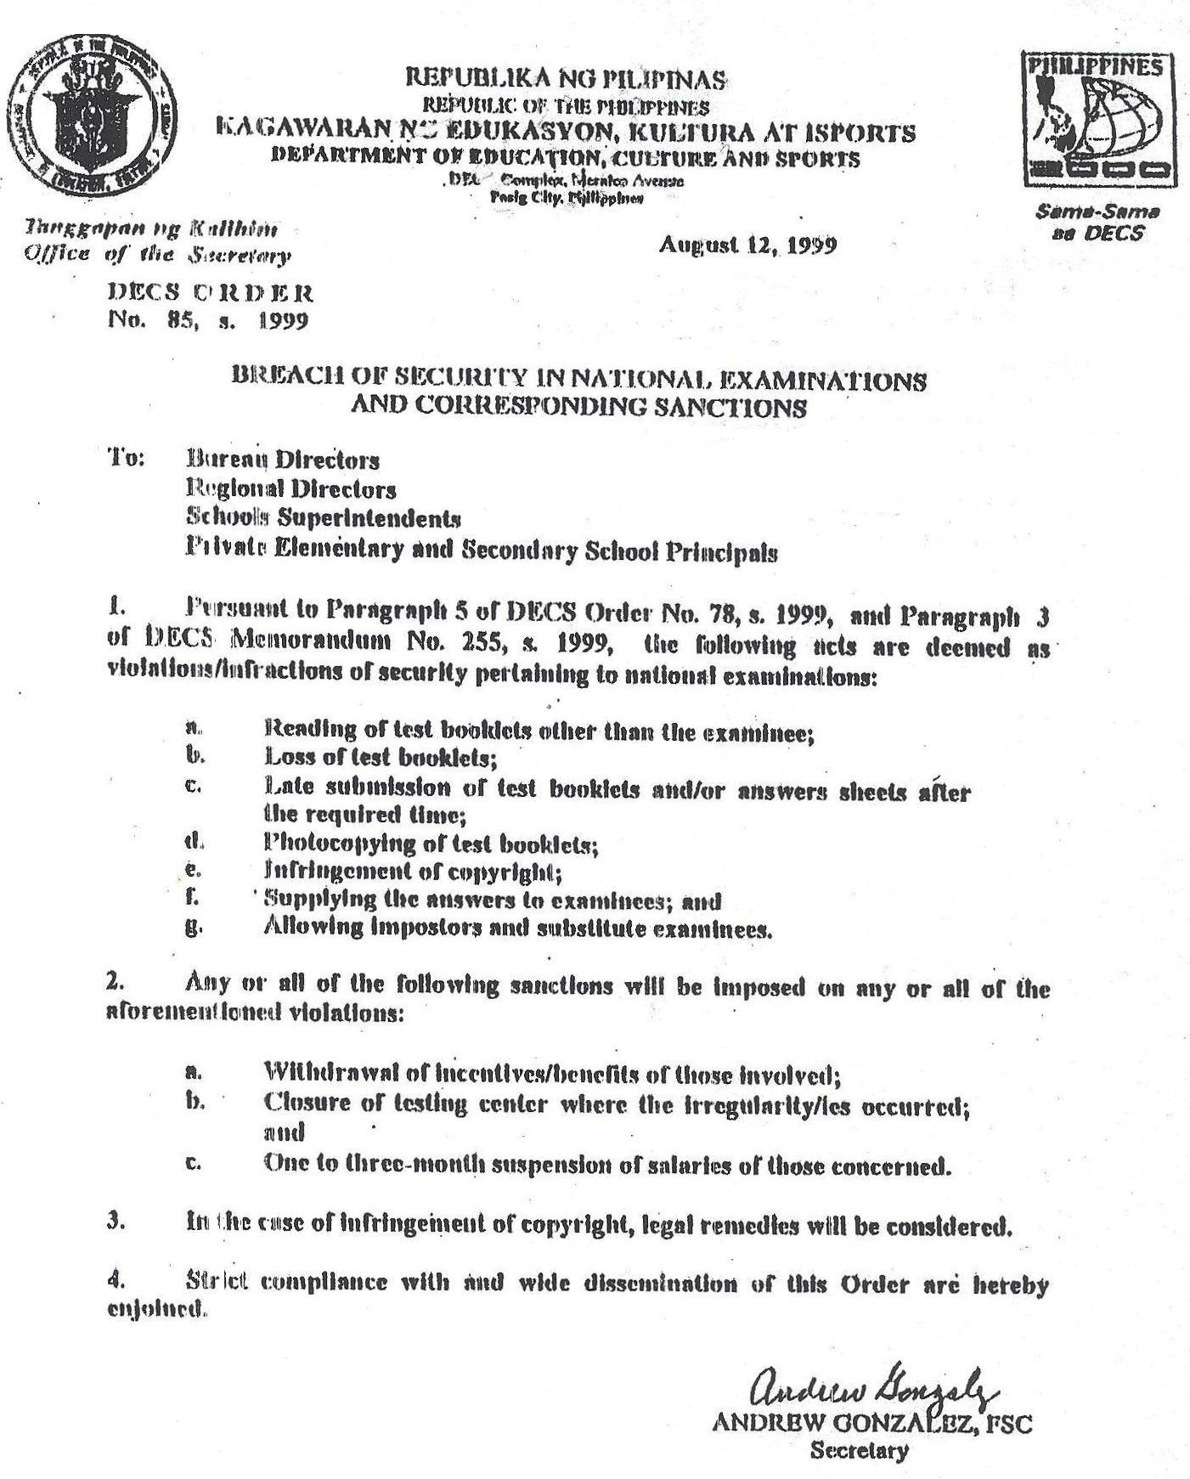

Slide 17
The Monitors
NETRC staff-monitors will be assigned to any testing center(s) nationwide, unannounced in the field.
The expenses incurred by external-volunteers are not chargeable to NETRC funds.

Slide 18
Orientation at the Division Level
This is primarily aimed to orient all the testing staff in the NCAE administration. But due to budgetary constraints only one representative per school is authorized to attend--either the SH or the STC. However, a 100% attendance is imposed for the school representative. Sanctions should be meted for non-attendance.
Hence, a mechanism should be devised so that all testing staff are properly oriented; one of which is orienting all the teaching force in the school by the SH/STC to be ready on exam day in case there will be shortage of REs in other testing centers.
A soft copy of the Examiner’s Handbook and the guidelines must be provided to School Heads to save printing cost.

Slide 19
The Enrolment Data, School ID and Learner Reference Number

Slide 20
Guidelines in the Preparation of Enrolment Data
1. Enrolment data must be in CD for Grade 9 following the format in DM No. 76, s. 2015;
The enrolment data should be based on July 1, 2015;
Use the Prescribed Standard Format in Excel. Enrolment data in other formats (Word, PDF, JPEG file) will be returned to the DTC;
Group schools by municipality and NOT by alphabetical order;
Provide data by legislative district; NOT by school district.

Slide 21
Matrix for the Grade 9 - Enrolment Data
 |  |  |  |  | Type of School
Region | Division | City / Municipality | Legislative | Division | (Public or Private) | School | Name of School | 2015-2016 Enrolment (G9)
 |  |  | District | Code |  | ID

Slide 22
Guidelines on the Use of School IDs
BEIS and NETRC are using similar School IDs both recognized by the Department;
New schools without School IDs are given temporary ones by the NETRC and no other sources to avoid duplication and to facilitate allocation of test materials;
The School IDs issued by NETRC will be used temporarily for future test administrations until such time BEIS issues the permanent ID;
In case there are several School IDs for one school, follow the School ID indicated in the Scannable School Header (SSH) and check the correctness of School ID in the TMs received.

Slide 23
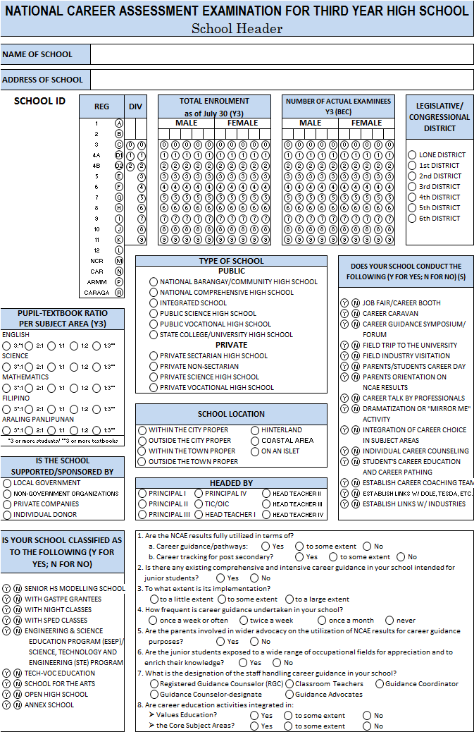
Discrepancy in the School ID
(School Header vs. EBEIS)
1. Update the School ID
Cross out the temporary School ID
Write the EBEIS School ID below the bar code

Slide 24
Guidelines on the Use of
Learner Reference Number (LRN)
Use the LRN that will be provided by the Office of the Planning Service, DepED Central Office.
The LRN must be reflected in each of the examinees’ AS , Form 1, List of Examinees to be posted at the door.

Slide 25
Test Administration Guidelines

Slide 26
Pre-Test Guidelines
Concern | Guidelines
Distribution Time for the Test Materials (TMs) | Early in the morning of Examination date in nearby schools
 | A day before the Examination date to far schools or earlier to far flung schools
Preparation of Classrooms | Only 30 chairs should be contained in the Examination Room, well-spread. First and last rows close to the walls.

Slide 27
Pre-Test Guidelines
Concern | Guidelines
Information Dissemination for Examinees | Inform the examinees to bring pencils (lead#2) on exam day.
 | 2. Inform the examinees taking the NCAE to bring snacks/lunch on exam day. They are not allowed to leave the school premises.
 | 3. Inform every examinee to be ready with the following information:
 | a) Region Code
 | b) Division Code
 | c) School ID
 | d) LRN
 | e) A copy of their Final Ratings in Grade 8 for Grade 9 takers
 | - Math, English, Science and TLE
 | Note: for NCAE - previous year Ratings
 | for NAT - Third Grading Period Ratings of current School Year

Slide 28
Pre-Test Guidelines
Concern | Guidelines
Information Dissemi-nation for Schools | Inform all schools that list of examinees must be alphabetically arranged in the whole school. Each listed examinee should have the corresponding LRN. All males first then the females.
 | 2. Private schools without permit to operate are excluded from Test Administration.
 | 3. Examinees from small-size private schools can be merged and tested in one testing center in a city or in a municipality. A Master Teacher shall be assigned as the CE.
 | 4. Merging of 5 or Less Excess Examinees
 | Large Testing Center - Examinees can be integrated in the last five rooms, each accommodating an examinee. The examinee will be the last in the list/seat plan. Customize Forms 1 and 3 in order to include the additional examinee. Add another box/space.

Slide 29
Pre-Test Guidelines
Concern | Guidelines
 | Small Testing Center
 | In case merging with other small testing centers is not possible, i.e. 35 examinees only, all examinees may be accommodated in one testing room. Another set of Forms 1 and 2 will be used for the 5 examinees.
 | Note: No integration of excess examinees will be done if there are enough testing rooms and room examiners (coming from other schools) to serve in the testing center.
 | 5. There should be a separate ETRE for each school in case there is merging of small size schools into one testing center.
 | 6. Rescheduling of the NCAE – Instruction from the SDS must prevail since they are most familiar with the status of the school.

Slide 30
Pre-Test Guidelines
Concern | Guidelines
Information Dissemination | 7. Inclusion Policies Examinees with Hearing Impairment (HI) They may take the test They may be included in the regular testing room Examinees who finished Grade 10 in other countries (with 12 years of basic education) They may take the test as long as they are classified as regular Grade 9 student in the Philippines Out-of-School Examinees They may be accommodated in the NCAE administration Use the buffer TM’s

Slide 31
Pretest : Entrance and Seating Arrangement
Check the identities of the examinees inside each Examination Room through their School ID.
Do not allow electronic devices – calculator & cell phones in the exam room.
All belongings shall be placed in front beneath the blackboard. Only pencils, sharpeners and a computation paper shall be with the examinees while test is going on.
Note:
No other persons should be allowed in the premises of the Examination Rooms except the testing staff and authorized monitors.

Slide 32
Instructions for the Recording of Time
Time allocation serves as guide in the recording of time but the corresponding actual time in answering each subject should be written in the time started and time to end in the board work.
The recording of time is done by cluster of subjects answered before and after breaks (snacks and lunch); for which the time records should be written on the blanks provided.

Slide 33
Filling Out the Scannable School Header (SSH)
Data must be prepared by the STC days ahead before exam day.
Transcribe the data in the SSH using a PENCIL (lead# 2) during examination day.
There are variables specific only for private schools (GASTPE) and for the public schools only (ALIVE, BEAM, etc.)
GASTPE Grantees (for private schools only) specified by year levels
- Take note of the bubbles for EVS and ECS.
Observe place values in filling out the variables.
Ex. 95%
0
9
5
100%
1
0
0

Slide 34
Filling Out the SSH
Nominal counts of Data. Start filling out the last box for one’s, next box for ten’s, next third box from the last is for hundreds, and so forth (zeroes have to be filled out for the empty boxes).
Example: An enrolment of 203 is filled out as:
An enrolment of 94 is filled out as:
Use the same School ID as prescribed by BEIS.
Take note of new features or additional information in every set of SH.
0
2
0
3
0
0
9
4

Slide 35
Allocation of Test Booklets and Scannable Answer Sheets
A. Test Booklets
Test Booklet | Allocation
TB1 – NCAE Core (comprising EDQ, Core and OIISSS) | 50%
TB2 – NCAE Tracks | 50%
B. Scannable Answer Sheets – 100%

Slide 36


On Photocopied Answer Sheets
In case there will be a shortage of Answer Sheets (ASs) in one testing center, Scannable Answer Sheets (SASs) may be photocopied.
The photocopied ASs SHOULD BE PLACED INSIDE THE RESPECTIVE ETRE corresponding with the list of actual examinees in Forms 1 and 2.
No Examinee Number should be written in Form 2 (Seat Plan) for the examinees with photocopied ASs. Instead, indicate in the blank “(Photocopied).”
Sample:
Using a red marker, indicate at the upper right corner of the ETRE this note:
The instructions above are important in order for NETRC to locate, transcribe and electronically process the photocopied ASs.
Name | Kristina M. Dela Cruz
Exam. No. | (Photocopied)
TB No.1 | 016657
TB No. 2 | 016657
With ___ Photocopied Answer Sheets (quantity) ROOM EXAMINER’S TRANSMITTAL REPORT ENVELOPE (ETRE) (Brown Envelope)

Slide 37
The Forms
Oath of Confidentiality
Form 1 – List of Actual Examinees
Form 2 – Seat Plan*
Form 3 – Test Materials Accounting Form*
Form 4 – Chief Examiner’s Report Form
Form 5 – Test Booklet Quantity and Completeness Verification Sheet
Form 6 – Answer Sheet Quantity and Completeness Verification Sheet
Form 7 – Room Examiner’s Test Administration Evaluation Report
*with modifications

Slide 38
The Generic Forms
Form 1
NETRC FORM 1
LIST OF ACTUAL EXAMINEES
REGION: __________________________________________ |  |  |  |  |  |  | DIVISION: ____________________________________________
SCHOOL: _____________________________________________________ |  |  |  |  |  |  | SCHOOL ID: _______________________
ADDRESS: ____________________________________________________ |  |  |  |  |  |  | Number of Males: ______ Number of Females: ______ Total: ______
YEAR LEVEL: __________
NAME |  | GASTPE Grantee |  | Learner Reference Number (LRN) |  |  | NAME |  | GASTPE Grantee |  | Learner Reference Number (LRN)
 |  | EVS | ECS |  |  |  |  |  | EVS | ECS
1 |  |  |  |  |  |  | 16
2 |  |  |  |  |  |  | 17
3 |  |  |  |  |  |  | 18
4 |  |  |  |  |  |  | 19
5 |  |  |  |  |  |  | 20
6 |  |  |  |  |  |  | 21
7 |  |  |  |  |  |  | 22
8 |  |  |  |  |  |  | 23
9 |  |  |  |  |  |  | 24
10 |  |  |  |  |  |  | 25
11 |  |  |  |  |  |  | 26
12 |  |  |  |  |  |  | 27
13 |  |  |  |  |  |  | 28
14 |  |  |  |  |  |  | 29
15 |  |  |  |  |  |  | 30
IMPORTANT
 | - To be accomplished by the Room Examiner.
 | -List names as they appear in the Seat Plan. |  |  |  |  |  |  | Room Examiner (RE)
 | - Leave the space blank if not a GASTPE grantee.
 | EVS - Education Voucher System
 | ECS - Education Contracting Service |  |  |  |  |  |  | School Station where RE teaches

Slide 39
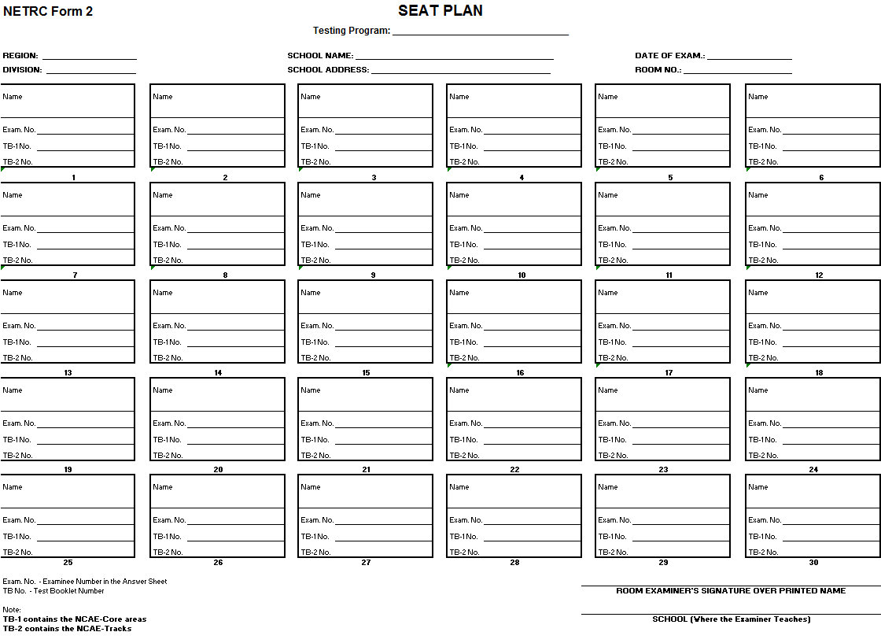
Form 2

Slide 40
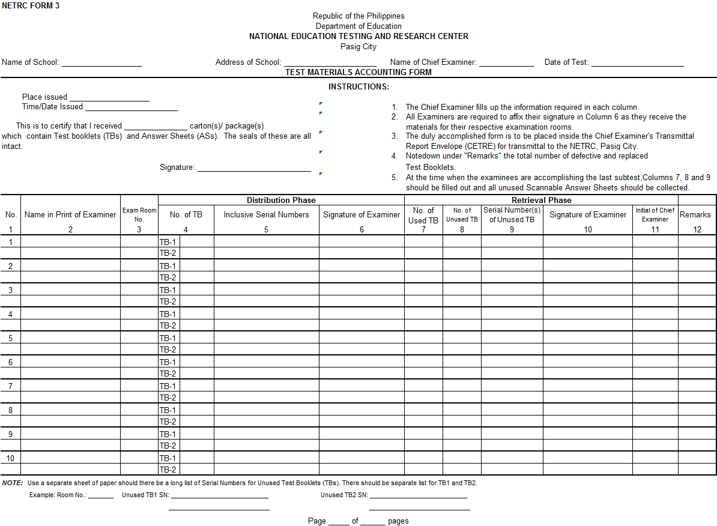
Form 3

Slide 41
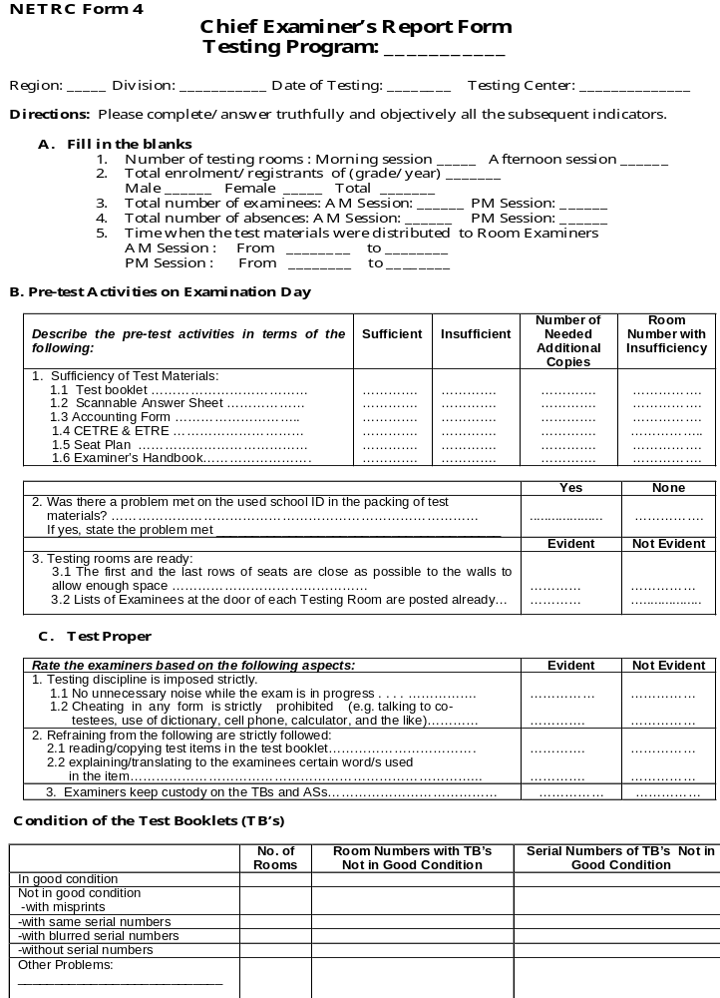
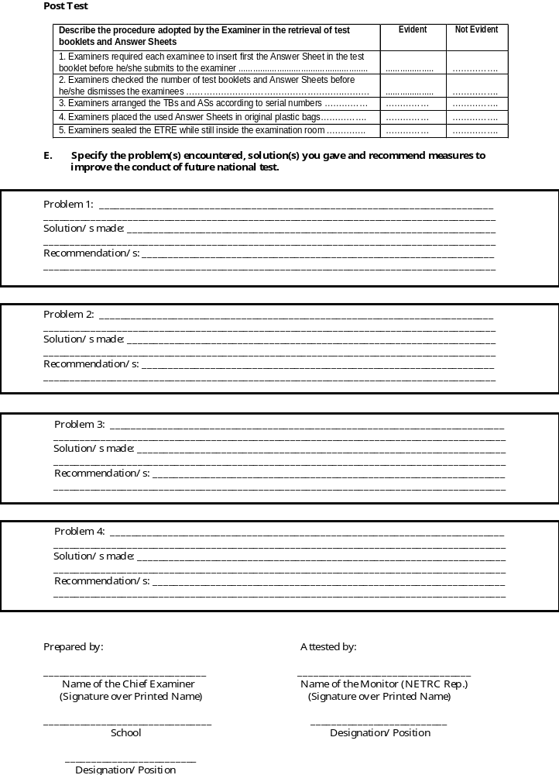
Form 4

Slide 42
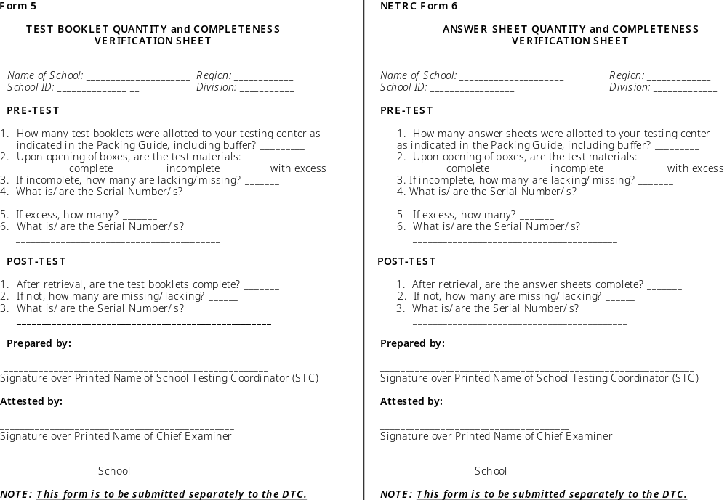
Forms 5 and 6

Slide 43
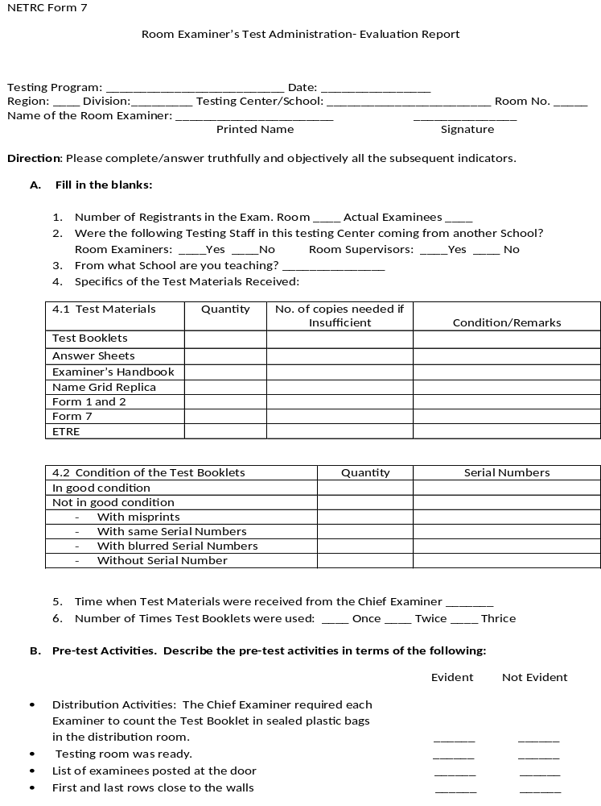
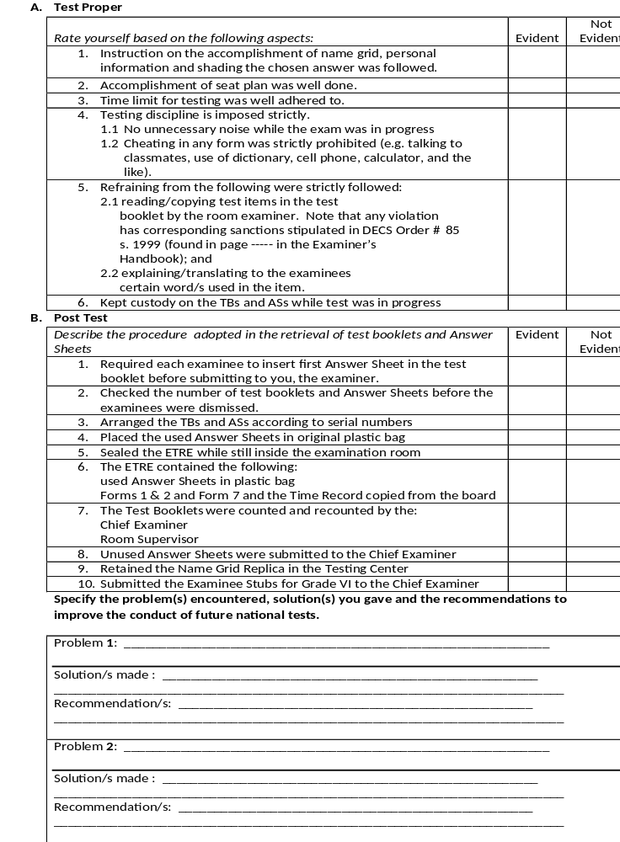
Form 7

Slide 44
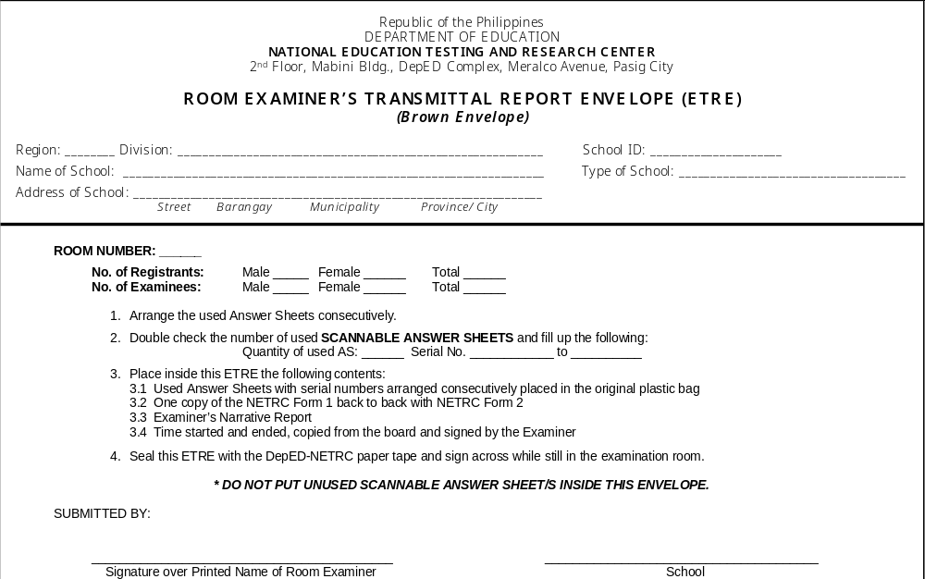
Room Examiner’s Transmittal Report Envelope

Slide 45
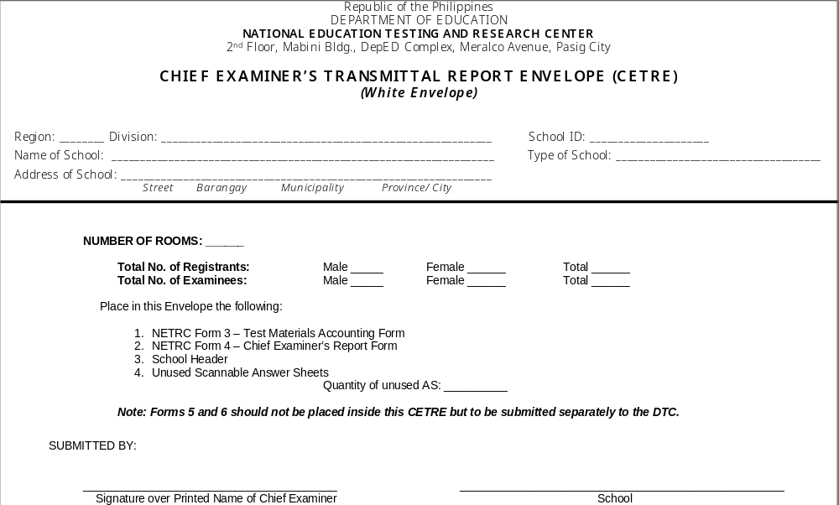
Chief Examiner’s Transmittal Report Envelope

Slide 46
The Forwarder of Test Materials

Slide 47
Dealing with the Forwarder of TMs
Exact addresses of Division Offices or drop-off points should be provided to NETRC to be turned over to the Forwarder.
Forwarder must provide NETRC contact persons and numbers as well as the itineraries of delivery and retrieval as ready reference.
Each Division should designate at least two authorized staff to receive the TMs other than the DTC.

Slide 48
Dealing with the Forwarder of TMs
The neighboring Divisions in the Region should establish a network of communication.
4.1 Every receiving Division should take note of Forwarder’s contact number and the date and time TMs will be retrieved
4.2 The next division to receive the TMs from the Forwarder should be alerted by the Division immediately after receiving its TMs while informing also the Forwarder that the next division to receive has been alerted already.
4.3 The same procedure will be followed in the retrieval of TMs.
4.4 Accomplish the evaluation form on the Performance of Forwarder and submit thru email (depednetrc@yahoo.com) – required by the Auditor

Slide 49
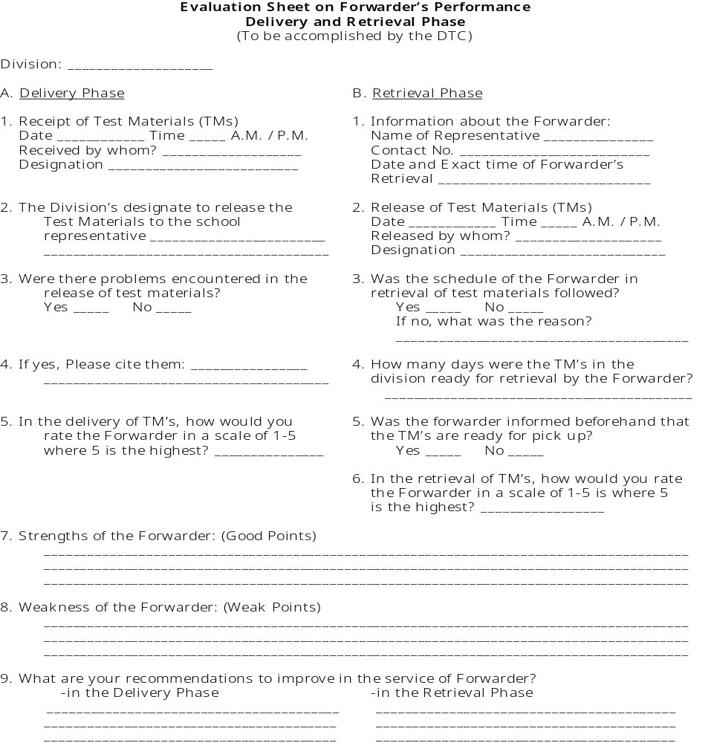
Evaluation Sheet on Forwarder’s Performance

Slide 50
TMs for Retrieval by the Forwarder
    All TBs packed in original boxes;
    All used ASs, Forms 1, 2 and 7 placed inside the ETRE’s;
    All unused ASs in CETREs together with Forms 3 and 4, and School Headers inside packed in original boxes for ASs ; and
    Forms 5 and 6 submitted to DTCs for proper placement in respective boxes
  Reminder:
  Don’t mix-up TBs with ASs. There are two separate warehouses for these TMs. Otherwise, misplaced TMs will not be accounted for properly.

Slide 51
Oath of Confidentiality
As part of the testing staff nationwide, tasked to receive, administer and retrieve the Test Materials for the National Career Assessment Examination (NCAE), I hereby solemnly swear that I will strictly observe security measures to maintain the confidentiality of these.
Received from: Received by:
(The Division Testing Coordinator) (School Head/School Testing
Coordinator)
____________________ ____________________
Print Name and Sign Print Name and Sign
____________________ ____________________
Date Date

Slide 52
Re-issuance of ncae cor

Slide 53

NCAE COR Request Form
NAME: (Surname, First Name, Middle Name)
SCHOOL NAME:
SCHOOL ADDRESS:
REGION: DIVISION:
PLACE OF EXAMINATION: ADDRESS:
DATE OF BIRTH: GENDER: YEAR GRADUATED:
CONTACT NUMBER:
Signature of Applicant Date

Slide 54
The EXAMINER’S HANDBOOK

Slide 55
NCAE Test Administration Scheme: Swapping of TBs
AM Session
Booklet 1
(EDQ, RC, MA, VA, SA, LRA, OIISSS)
Odd-numbered rows
AM Session
Booklet 2
(HUMSS, STEM, ABM, TVA)
Even-numbered rows
PM Session
Booklet 2
(HUMSS, STEM, ABM, TVA)
Odd-numbered rows
PM Session
Booklet 1
(EDQ, RC, MA, VA, SA, LRA, OIISSS)
Even-numbered rows
ODD
EVEN
AM
PM

Slide 56
On the Storage of Examiner’s Handbook and Replicas of Name Grid
EH will be stored in the Division Office. Name Grid replicas will be stored in the schools or testing centers. Both documents are for future use.
Replicas of the name grid and Board Work intended for each testing program should be properly stored and utilized in each school. These are generic to all testing programs; hence, may be used in future testing activities in case no reprints will be provided.

